Slide 1




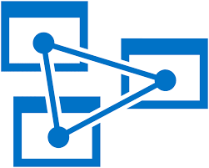
Advanced Semantic Model development
with Tabular Editor

Slide 2
Practical info
If you want free parking – contact the organizers
Lunch at 12:10 – 13:10

Slide 3
Agenda
Round-table introductions and expectations
Introduction to AMO and TOM
Demo: TOM vs TMSL vs TMDL vs XMLA
TOM Exploration using Tabular Editor
C# scripting with Tabular Editor
TOM Exploration using Other Tools
Advanced TOM Objects and Properties
Best Practice Analyzer and custom rules
Automation with the Tabular Editor CLI
Additional Considerations

Slide 4
About me
Daniel Otykier
Inventor of Tabular Editor
CTO @ Tabular Editor ApS
Microsoft Data Platform MVP (5 years)
Power BI Contributor (“External Tools” ribbon)

Slide 5
Show of hands
0 hands = No, ½ hand = Somewhat, 1 hand = Yes, 2 hands = Yes, very much
Are you familiar with Power BI semantic models or Analysis Services tabular models?
Are you familiar with the Tabular Object Model (TOM)?
Are you familiar with Tabular Editor (2 or 3)?
Are you familiar with C# scripting in Tabular Editor?

Slide 6
What to expect from this training
Skills gained:
A solid understanding of the Tabular Object Model (TOM), and advanced objects/properties within it.
Navigating and exploring the TOM with Tabular Editor
A basic understanding of C# syntax, sufficient for writing advanced scripts in Tabular Editor
Practical skills for writing useful C# scripts, that make you more productive when developing Semantic Models
Solid understanding of how Tabular Editor’s Best Practice Analyzer works, enabling you to create custom Best Practice Analyzer rules
Knowledge about other tools for TOM exploration and automation
Knowledge about automation, enabling advanced management scenarios for DevOps and Deployment

Slide 7
Prerequisites
Tabular Editor 2 or 3 installed and ready to go
Sample material and exercises:
https://github.com/otykier/training

Slide 8
SpaceParts SQL data source
Server name: te3-training-eu.database.windows.net
Database name: SpacePartsCoDW
SQL username: dwreader
SQL password: TE3#reader!

Slide 9

Introduction to AMO and TOM
Metadata: The unsung hero behind every great semantic model!

Slide 10
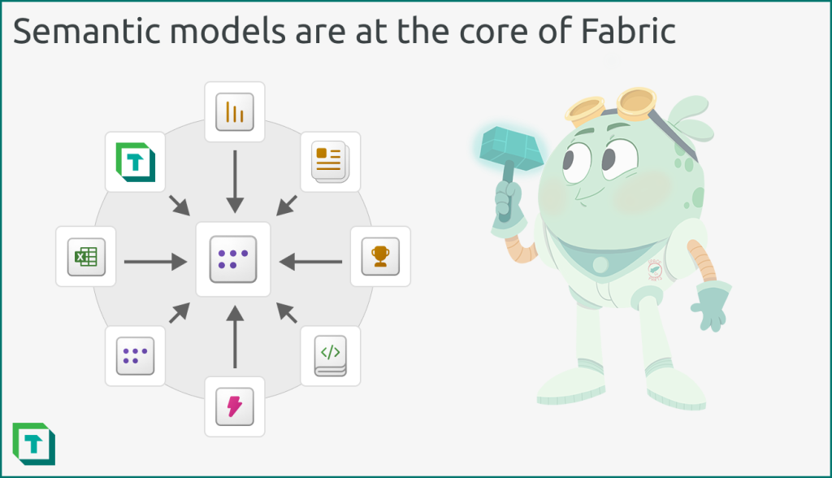
Semantic models
Business friendly
Use data from source systems to model real-world processes and entities
Desirable qualities:
Complete
Accurate
Performant
Organized
Secure
Scalable
Flexible
https://blog.tabulareditor.com/2023/11/17/semantic-models-in-simple-terms/
Notes:
The “semantic” part of a semantic model, means that the data has meaning to a person or organization (ProductCode or Quantity)
The “model” part means that objects and calculations represent real-world processes or objects, such as business transactions, customer interactions or company headcounts
Complete: Consists of sufficient attributes and calculations to answer the relevant business questions in scope.
Accurate: Calculations and logic in the model accurately reflect the real-world processes and systems that it’s intended to represent.
Performant: Both data refresh (for import models) and DAX queries (in report visuals or connected client tools) are fast.
Organized: Ensuring the model is consistent and easy to use from the different client tools who connect to it.
Secure: Has the appropriate data security (like row-level security) to prevent access of data by unauthorized individuals.
Scalable: Is designed and implemented to handle increasing data volumes, complexity, and user queries over its defined lifespan.
Flexible: Can easily (and quickly) be adapted to changing business needs, where appropriate.

Slide 11
Semantic models
Not a new concept (“semantic layer”)
Not a new technology
Microsofts in-memory, columnar storage engine and the DAX formula language dates back to Project Gemini (2006) which became PowerPivot (2009).
Same engine used across PowerPivot (2009), SQL Server Analysis Services (2012), Power BI Desktop (2015), and now Microsoft Fabric (2023)
Not a new programming model
Microsoft provided client libraries for making programmatic changes to OLAP models in 2005 with AMO (Analysis Management Objects)
Major overhaul in 2016 with AMO/TOM (Tabular Object Model)
How did we get here?

Slide 12
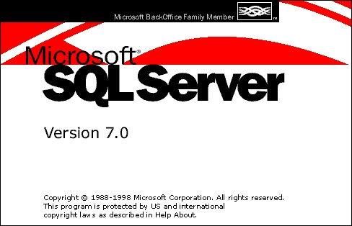
A brief history of time…
1998: OLAP Services in Microsoft SQL Server 7.0
Multidimensional models and MDX
Notes:
Pre 1998: Microsoft starting to explore OLAP opportunities in addition to the OLTP offerings already provided by SQL Server (which had been on the market the early 90s)
1998: OLAP Services launched, with support for MOLAP, ROLAP and HOLAP – proprietary query language MDX, and OLE DB for OLAP as client access API

Slide 13
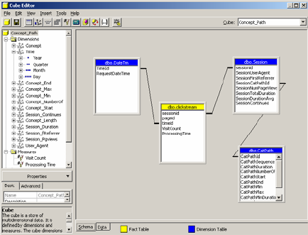
A brief history of time…
1998: OLAP Services in Microsoft SQL Server 7.0
Multidimensional models and MDX
2000: Analysis Services in SQL Server 2000
XMLA spec as a successor for OLE DB for OLAP
XMLA council formed in 2002
Notes:
2000: Data Mining services (yes, that’s what we called Machine Learning and AI back in the days) included, so OLAP Services rebranded to Analysis Services – support for Parent-Child hierarchies, new calculation engine with support for unary operators, custom rollups and cell calculations, HTTP connectivity
2002: XMLA spec v. 1.1 – a SOAP based protocol to define data access interaction between a client application and an analytical data provider
2005: AMO (Analysis Management Objects) for working programmatically with multidimensional databases and data mining

Slide 14
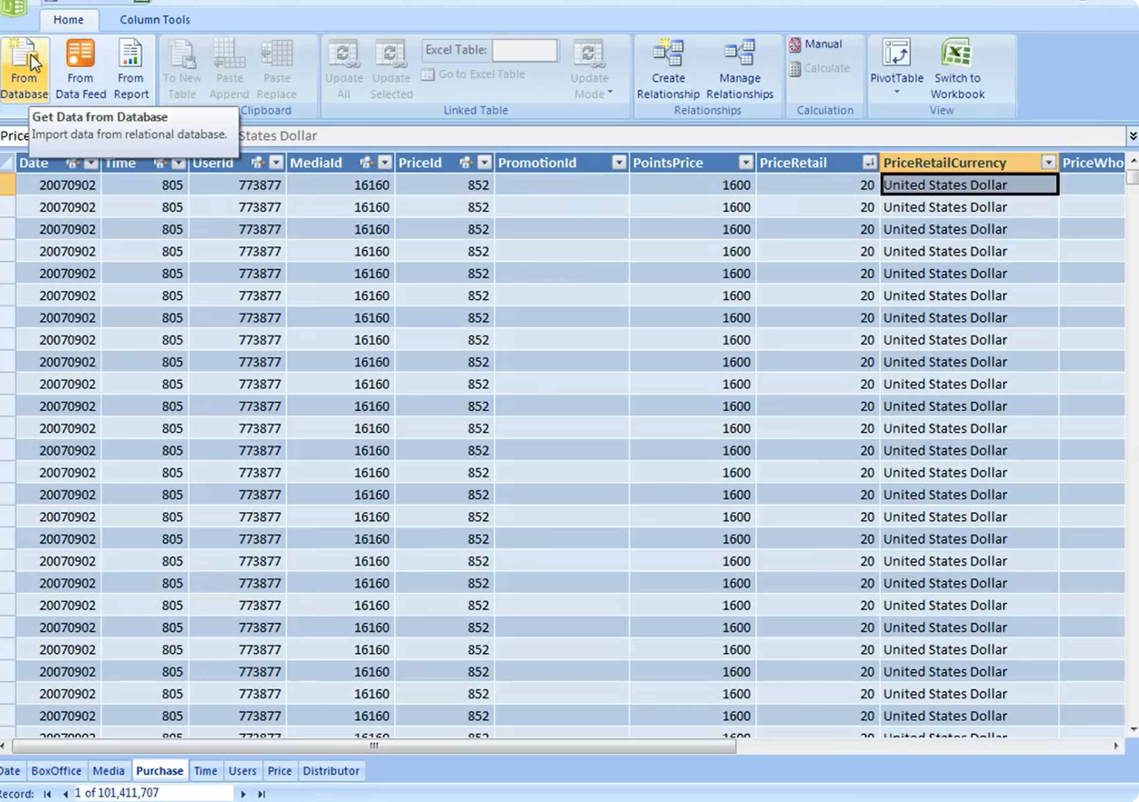
A brief history of time…
1998: OLAP Services in Microsoft SQL Server 7.0
Multidimensional models and MDX
2000: Analysis Services in SQL Server 2000
XMLA spec as a successor for OLE DB for OLAP
XMLA council formed in 2002
2006: Project Gemini – bring the power of SSAS to Excel
Notes:
2006: Project Gemini launched by Amir Netz – the precursor to Power Pivot and Analysis Services Tabular
The goal: To create a high-performance analytics engine, which doesn’t require specialty knowledge to set up – it should be as easy to use as regular Pivot Tables in Excel, with a formula language that would be familiar to Excel users

Slide 15

A brief history of time…
1998: OLAP Services in Microsoft SQL Server 7.0
Multidimensional models and MDX
2000: Analysis Services in SQL Server 2000
XMLA spec as a successor for OLE DB for OLAP
XMLA council formed in 2002
2006: Project Gemini – bring the power of SSAS to Excel
2009: Power Pivot for Excel and SharePoint with SQL Server 2008 R2
Tabular models and DAX
Notes:
2010: Power Pivot with the new “tabular data engine” which uses DAX as a formula language. No more explicit dimensions, measure groups, facts, attribute hierarchies, etc. Only tables, columns, relationships and measures.

Slide 16

A brief history of time…
1998: OLAP Services in Microsoft SQL Server 7.0
Multidimensional models and MDX
2000: Analysis Services in SQL Server 2000
XMLA spec as a successor for OLE DB for OLAP
XMLA council formed in 2002
2006: Project Gemini – bring the power of SSAS to Excel
2009: Power Pivot for Excel and SharePoint with SQL Server 2008 R2
Tabular models and DAX
2012: The BI Semantic Model (BISM): SSAS in Tabular mode
Notes:
2012: The BISM – Analysis Services now available in Tabular Mode on SQL Server 2012, enabling unprecedented high-performance in-memory analytics on billions of rows (thanks to the VertiPaq compression). Still using the XMLA-based metadata format.

Slide 17
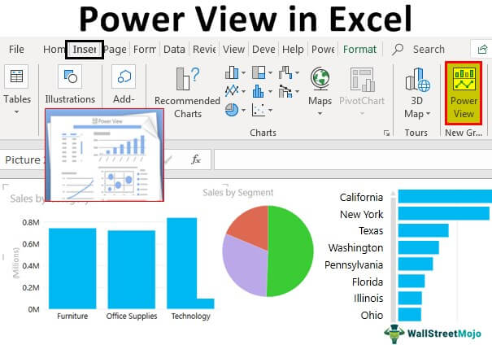
A brief history of time…
1998: OLAP Services in Microsoft SQL Server 7.0
Multidimensional models and MDX
2000: Analysis Services in SQL Server 2000
XMLA spec as a successor for OLE DB for OLAP
XMLA council formed in 2002
2006: Project Gemini – bring the power of SSAS to Excel
2009: Power Pivot for Excel and SharePoint with SQL Server 2008 R2
Tabular models and DAX
2012: The BI Semantic Model (BISM): SSAS in Tabular mode
2013: “Power BI for Office 365”
a precursor to the modern day Power BI service
using DAX-based Power View for visualizations
Notes:
2013: Power BI starts to take shape, using the Tabular Mode engine to host the data and Power View (based on SilverLight) as the visualization layer

Slide 18
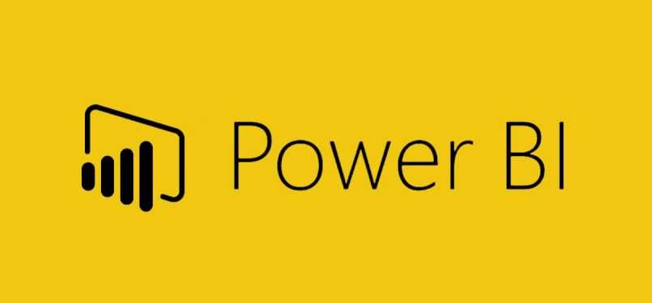
A brief history of time…
1998: OLAP Services in Microsoft SQL Server 7.0
Multidimensional models and MDX
2000: Analysis Services in SQL Server 2000
XMLA spec as a successor for OLE DB for OLAP
XMLA council formed in 2002
2006: Project Gemini – bring the power of SSAS to Excel
2009: Power Pivot for Excel and SharePoint with SQL Server 2008 R2
Tabular models and DAX
2012: The BI Semantic Model (BISM): SSAS in Tabular mode
2013: “Power BI for Office 365”
a precursor to the modern day Power BI service
using DAX-based Power View for visualizations
2015: Power BI Desktop launches – tabular models now called “datasets”
Notes:
2015: Power BI Desktop as we know it today is released. No more SilverLight – all HTML-based. To accompany it, the powerbi.com service is made available to the public. Tabular models published to the service are called “datasets”

Slide 19
A brief history of time…
1998: OLAP Services in Microsoft SQL Server 7.0
Multidimensional models and MDX
2000: Analysis Services in SQL Server 2000
XMLA spec as a successor for OLE DB for OLAP
XMLA council formed in 2002
2006: Project Gemini – bring the power of SSAS to Excel
2009: Power Pivot for Excel and SharePoint with SQL Server 2008 R2
Tabular models and DAX
2012: The BI Semantic Model (BISM): SSAS in Tabular mode
2013: “Power BI for Office 365”
a precursor to the modern day Power BI service
using DAX-based Power View for visualizations
2015: Power BI Desktop launches – tabular models now called “datasets”
2016: SQL Server 2016
Compatibility Level 1200, TMSL and TOM
Tabular Editor released
Notes:
2016: SQL Server 2016 – compatibility level 1200 and conversion from XMLA to TMSL. The Tabular Object Model (TOM) introduced as part of the AMO client library, enabling all the goodness of Tabular Editor and other tools

Slide 20
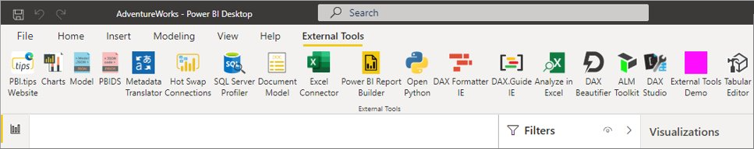
A brief history of time…
1998: OLAP Services in Microsoft SQL Server 7.0
Multidimensional models and MDX
2000: Analysis Services in SQL Server 2000
XMLA spec as a successor for OLE DB for OLAP
XMLA council formed in 2002
2006: Project Gemini – bring the power of SSAS to Excel
2009: Power Pivot for Excel and SharePoint with SQL Server 2008 R2
Tabular models and DAX
2012: The BI Semantic Model (BISM): SSAS in Tabular mode
2013: “Power BI for Office 365”
a precursor to the modern day Power BI service
using DAX-based Power View for visualizations
2015: Power BI Desktop launches – tabular models now called “datasets”
2016: SQL Server 2016
Compatibility Level 1200, TMSL and TOM
Tabular Editor released
2020: Support for External Tools in Power BI Desktop
Notes:
2020: External Tools ribbon added to Power BI Desktop, marking the first official support for XMLA-based edits to the data model of a report loaded in Power BI Desktop

Slide 21
A brief history of time…
1998: OLAP Services in Microsoft SQL Server 7.0
Multidimensional models and MDX
2000: Analysis Services in SQL Server 2000
XMLA spec as a successor for OLE DB for OLAP
XMLA council formed in 2002
2006: Project Gemini – bring the power of SSAS to Excel
2009: Power Pivot for Excel and SharePoint with SQL Server 2008 R2
Tabular models and DAX
2012: The BI Semantic Model (BISM): SSAS in Tabular mode
2013: “Power BI for Office 365”
a precursor to the modern day Power BI service
using DAX-based Power View for visualizations
2015: Power BI Desktop launches – tabular models now called “datasets”
2016: SQL Server 2016
Compatibility Level 1200, TMSL and TOM
Tabular Editor released
2020: Support for External Tools in Power BI Desktop
2023: Datasets renamed to Semantic Models
Notes:
2023: With the launch of Microsoft Fabric, datasets are renamed to semantic models

Slide 22
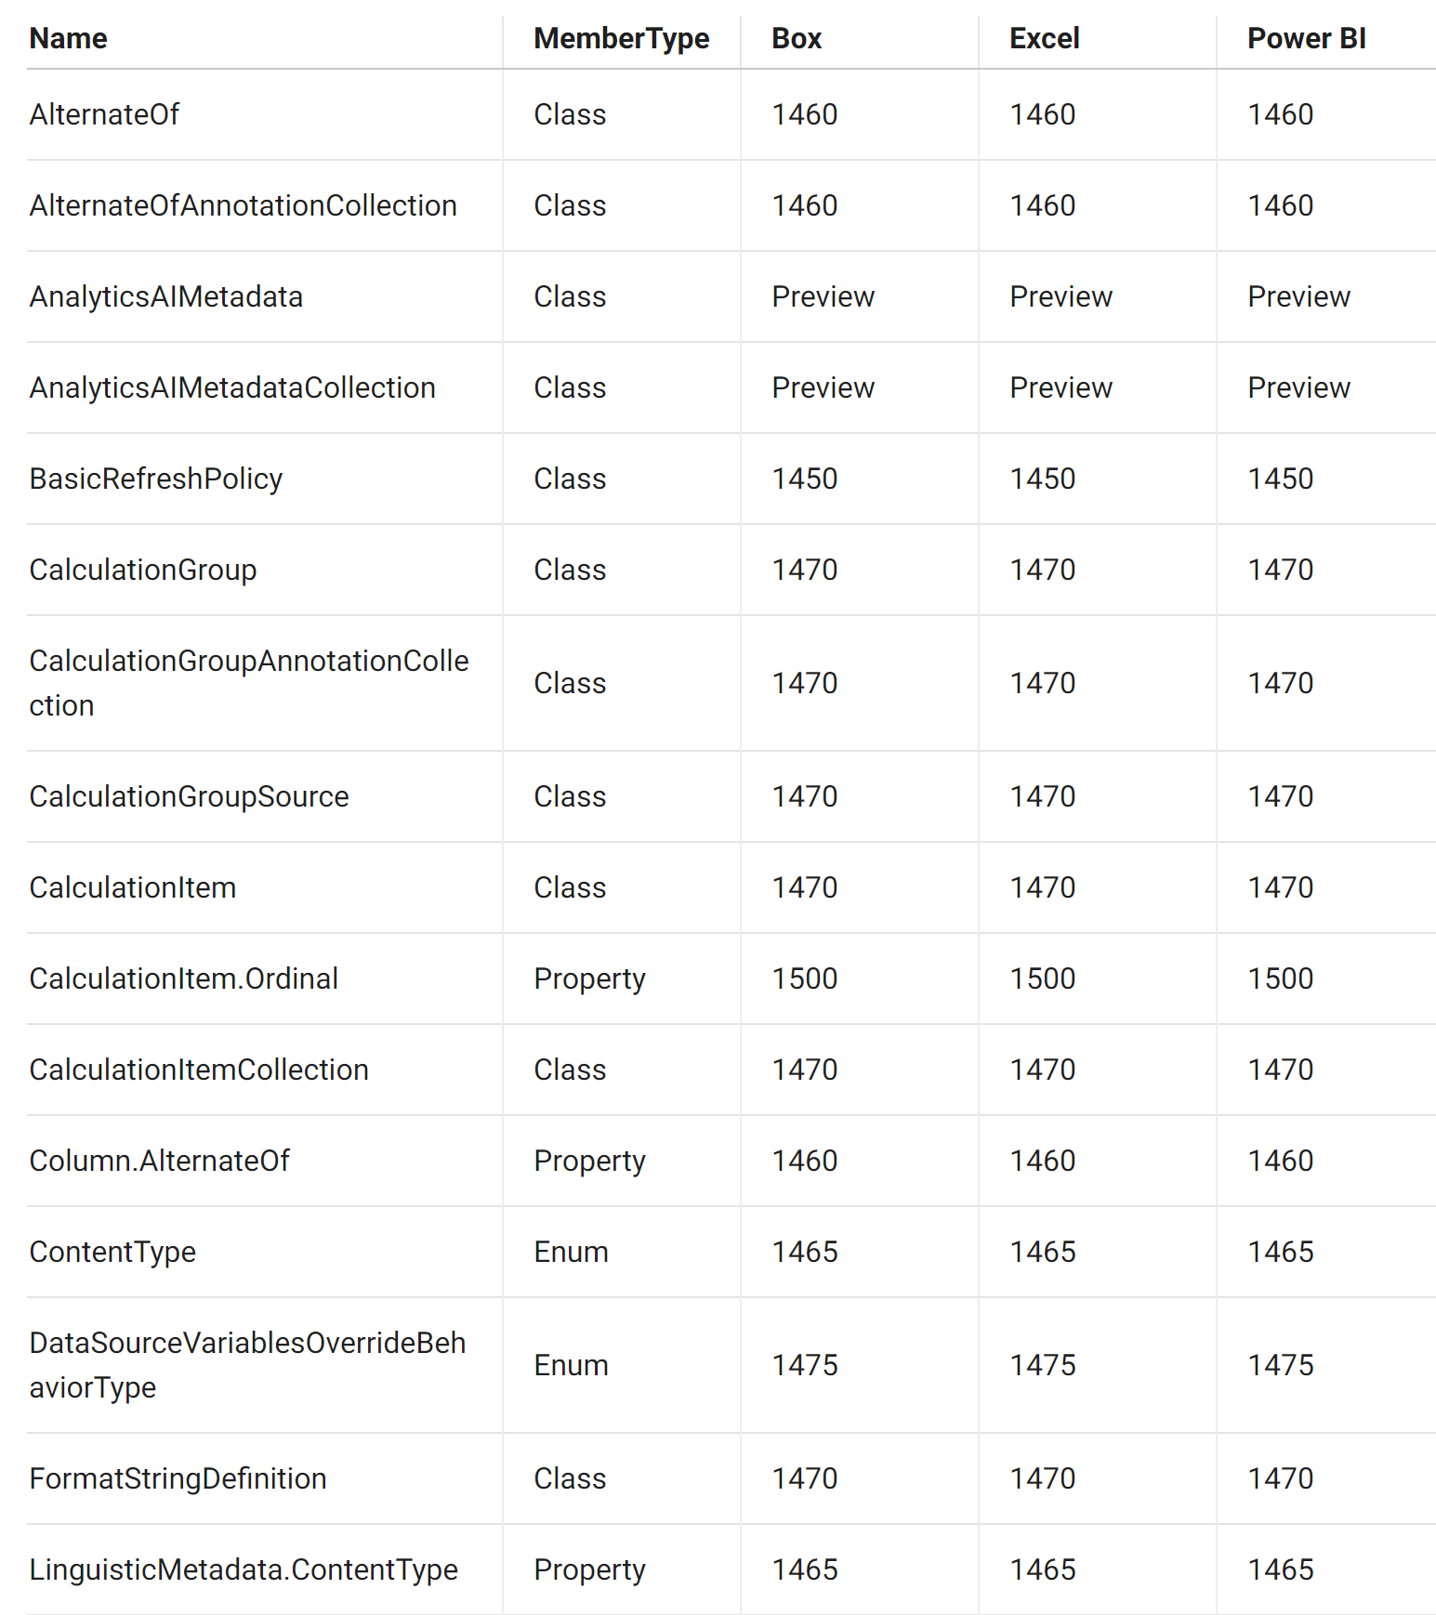
A note on Compatibility
Three different “flavours” of semantic models
CompatibilityMode.AnalysisServices
CompatibilityMode.PowerBI
CompatibilityMode.Excel
Many different features – new added all the time
Available features tracked by Compatibility Level
1100, 1103: Pre-TOM (SQL Server 2012 and 2014)
1200 (SQL Server 2016)
1400 (SQL Server 2017)
1500 (SQL Server 2019)
1600 (SQL Server 2022)
- and many levels in between

Slide 23
Compatibility gotchas
CompatibilityLevel:
Upgrades always possible
In-place downgrades not possible
Offline downgrades only possible when model doesn’t use any features of the lower level
CompatibilityMode
AnalysisServices → PowerBI always possible
Reverse only when model uses no PowerBI-specific features
PowerBI specific features
Implicit data sources
Direct Lake mode
Composite models
…and more: https://powerbi.microsoft.com/en-us/blog/power-bi-premium-and-azure-analysis-services/

Slide 24
One size never fits all…
Programmability / extensibility is key to making your platform appeal to the widest possible audience
Even the Microsoft Office products have “macros”…
Feature doesn’t exist? Bake it in yourself!
MDX even had user-defined functions!
Need to automate something? Create a script!
Bottom line: Semantic models are fully programmable!

Slide 25
Client libraries
MSOLAP (OLE DB provider)
Low level native client library, for Analysis Services database connections
AMO (Analysis Management Objects)
Managed (.NET) client library. Used by SQL Server Management Studio and Visual Studio
Read-write (requires admin or refresh permissions)
Multi-dimensional models
Data refresh
Data mining
Server-level properties
Extended Events / Tracing
AMO/TOM (Tabular Object Model)
A subset of AMO, specifically for administering and working with Analysis Services servers in Tabular mode
Working programmatically with all objects in the Tabular Object Model
ADOMD.NET
Read-only connection
Querying using cellset (MDX) or tabular (DMV/DAX)
https://learn.microsoft.com/en-us/analysis-services/client-libraries?view=asallproducts-allversions

Slide 26
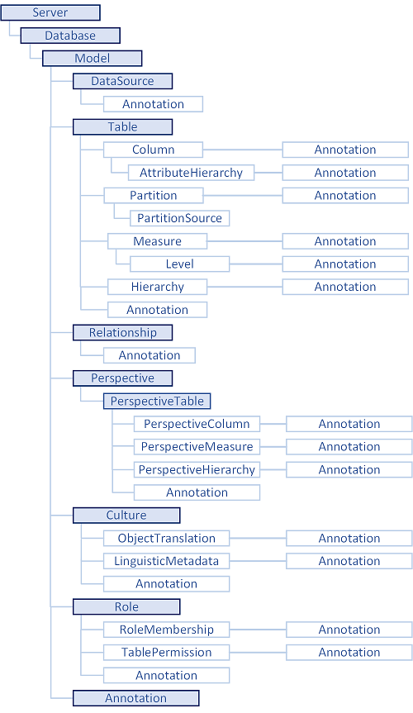
Understanding TOM
Object model that represents the metadata structure of semantic models
Every “thing” in a semantic model represented by an “object” in TOM, e.g.:
Tables
Columns
Measures
etc.
Backbone of the tabular modelling experience
https://learn.microsoft.com/en-us/analysis-services/tom/introduction-to-the-tabular-object-model-tom-in-analysis-services-amo?view=asallproducts-allversions

Slide 27
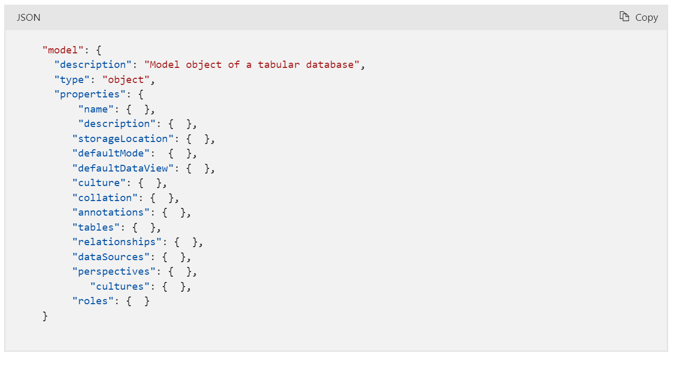
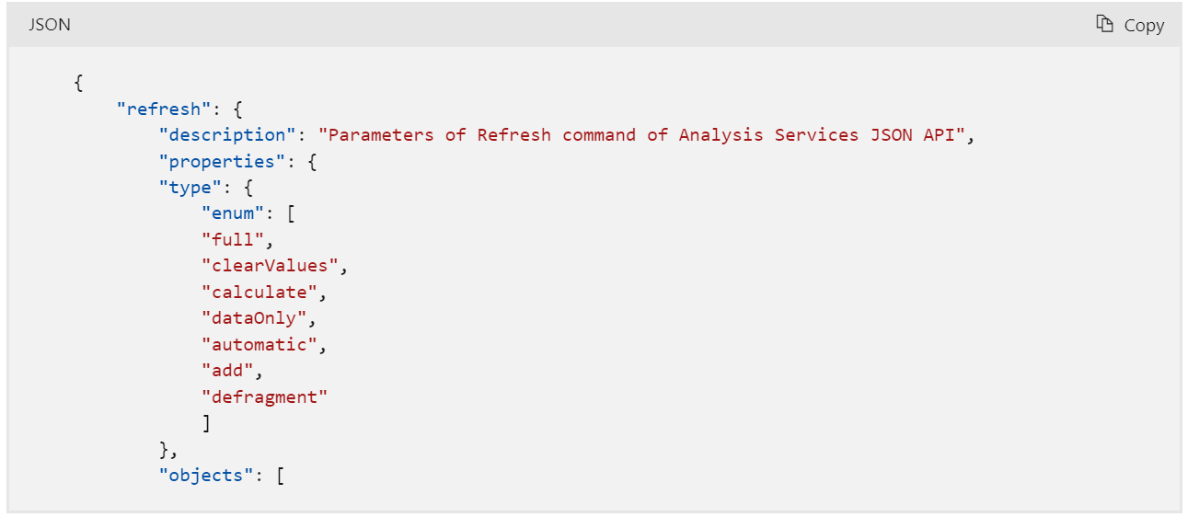
Understanding TMSL
TMSL “DDL”:
TMSL is actually two things:
TMSL “DDL”:
Just a simple JSON representation of the TOM
Default semantic model metadata storage format of Visual Studio and Power BI
Model.bim files
Tabular Editor’s “Save-to-folder” is also based on TMSL “DDL”, but with individual objects in the JSON tree, stored as individual files
Will eventually be replaced by TMDL (for better source control integration)
TMSL “DML”:
Various commands and statements, expressed in JSON and often embedding TMSL “DDL”, to refresh or modify a deployed semantic model
Seen when using the “Script” feature in SSMS
Tabular Editor can generate TMSL “DML” scripts for various operations as well, for example partition merging
Not supported by Power BI Desktop
TMSL “DML”:

Slide 28
TOM vs. TMSL vs. TMDL vs. XMLA
Confused yet? ☺ Let’s recap:
TOM: Programmatic object model
TMSL: Tabular Model Scripting Language (is actually 2 things):
TMSL ”DDL”: TOM when serialized to JSON (Model.bim file)
TMSL “DML”: Commands for performing various metadata operations, such as refreshes, partition merges, creating/altering TOM objects, etc.
TMDL: Tabular Model Definition Language
Human friendly alternative to TMSL “DDL” – more like YAML than JSON
XMLA: Protocol for communication between client and server
Used by AMO and AMO/TOM
Can envelope TMSL “DML” commands (but not against Power BI Desktop ☹)
Can envelope all types of queries (MDX, DAX, DMV)
Notes:
Here it would be nice with a demo / break that illustrates all 4:
TOM: Show a Visual Studio console app that uses TOM to add a measure to a model
TMSL “DDL”: Show a model.bim file
TMSL “DML”: Show scripting in SSMS and Tabular Editor
TMDL: Show a PBIX file saved as TMDL using Developer Mode
XMLA: Launch SQL Profiler to demonstrate XMLA messages

Slide 29
Demo
TOM vs TMSL DDL vs TMSL DML vs TMDL vs XMLA

Slide 30
But wait, there’s more…
Conceptual Schema Definition Language (CSDLBI)
Used by client tools to retrieve the metadata relevant for presenting the semantic model structure to end users
Analysis Services Scripting Language (ASSL)
Equivalent to TMSL DML for Multi-dimensional models
Notes:
We only mention these for completeness. Unless you’re building your own client for Analysis Services, don’t worry about this…

Slide 31
“New” kid on the block: TOMWrapper
.NET library originally created for Tabular Editor
TOMWrapper as standalone client library coming soon (thanks to Mathias Thierbach @ pbitools)
Wraps TOM and provides convenient access to commonly used objects and properties
Tracks changes (enabling Tabular Editor to perform undo/redo)
Simple dependency detection and formula fixup
No actual DAX parser in TE2
Based on tokenization of DAX expressions – not 100% foolproof, but gets the job done
Enables Tabular Editor’s Best Practice Analyzer

Slide 32
Semantic Model programmability
C# scripts through Tabular Editor
Managed (.NET) applications using TOMWrapper.dll
Managed (.NET) applications using AMO/TOM directly
TMSL scripts in SSMS
TMSL/TMDL metadata in Notepad (or other text editor)
Python w/Semantic Link Labs (Microsoft Fabric only)
PowerShell
Through Invoke-ASCmd and TMSL scripts
PowerShell through AMO/TOM or other managed (.NET) libraries

Slide 33
Semantic Model programmability
Method | Pros | Cons
C# scripts through Tabular Editor | Easy to get started Many samples online Immediately see script impact in Tabular Editor Rollback/undo functionality | Requires 3rd party tool install C# skills required (IntelliSense lacking)
.NET application using TOMWrapper | More flexible, while still compatible with C# scripts Can use VSCode / Visual Studio | Requires IDE installation (VSCode / VS) Takes time to set up initially Requires more custom development
.NET application using AMO/TOM | Pure 1st party custom solution Can use VSCode / Visual Studio | Same cons as above + no Tabular Editor specific extensions / helper methods
TMSL scripts in SSMS | Pure 1st party solution Easy to get started | Difficult/cumbersome to achieve true programmability/automation Doesn’t work with PBI Desktop
Notepad | Pure 1st party solution Easy to get started Pure offline solution | Difficult/cumbersome to achieve true programmability/automation No syntax validation / limited 1st party tooling
PowerShell | Pure 1st party custom solution | PowerShell ☺
Semantic Link Labs | Run in Fabric Notebooks – does not require installation of any tools locally | Requires Microsoft Fabric / no offline mode Python skills required

Slide 34
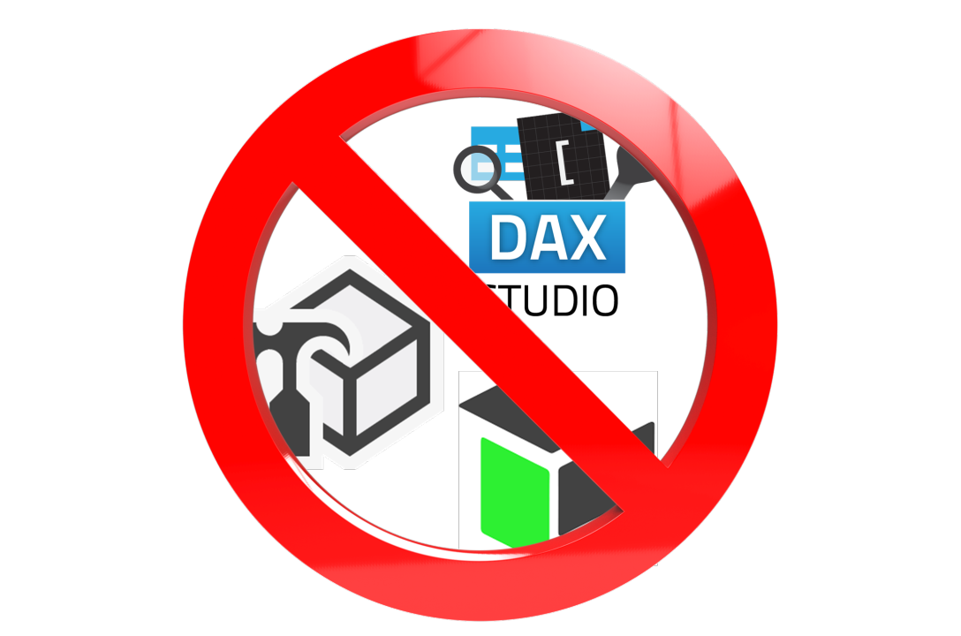
Summing up
Lots of terminology here - don’t be confused
AMO/TOM is what enables us to work programmatically with semantic models
Tabular Editor is the easiest option, most accessible option for semantic model programmability
1st party programmability options available
Requires more code, more time, or both
You don’t strictly need Tabular Editor for advanced semantic modelling. But it will make your life easier.
https://www.linkedin.com/pulse/semantic-modeling-without-third-party-tools-daniel-otykier-okr8f/

Slide 35
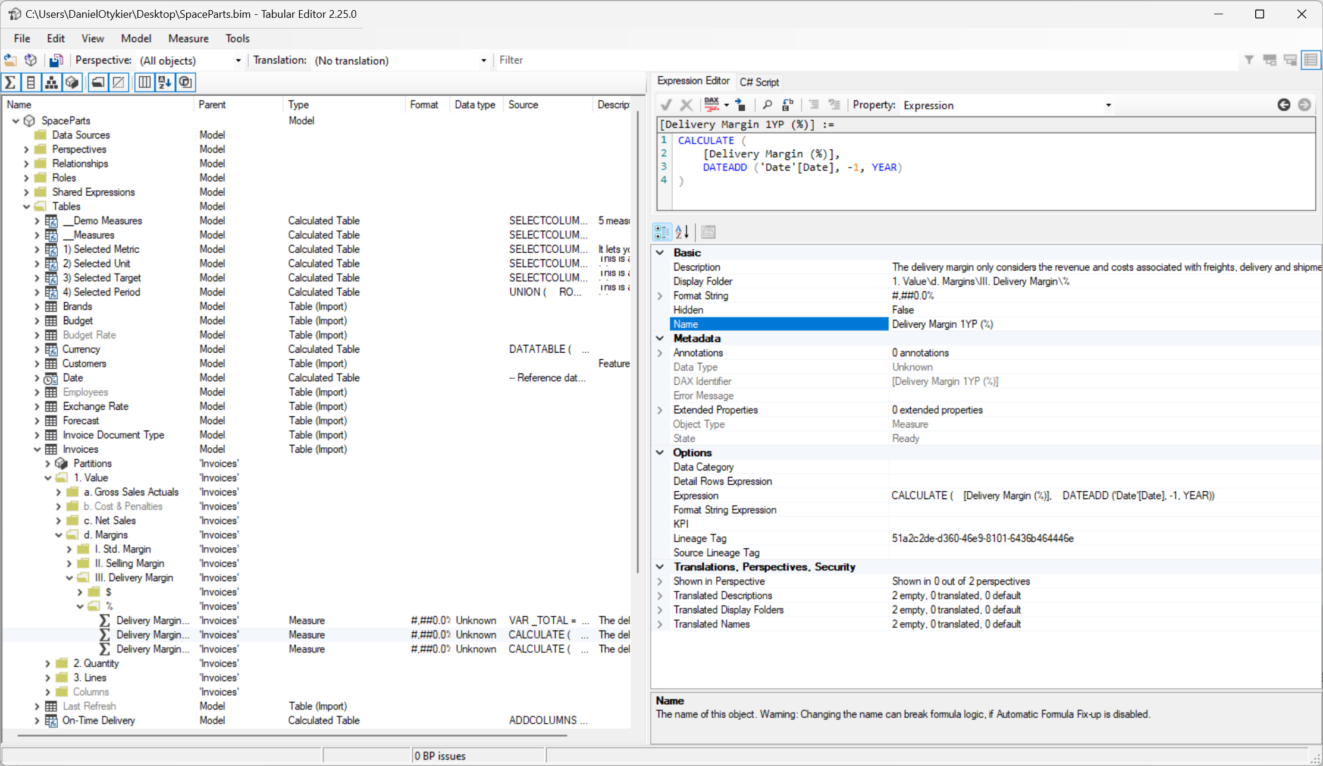
TOM Exploration using Tabular Editor
So much metadata. How could folks even get things done before Tabular Editor?

Slide 36
TOM Explorer
Hierarchical view of (a simplified version of) TOM
Why doesn’t it match TOM 100%?
TOM has objects for many things for abstraction purposes
PartitionSourceType, DetailRowsDefinition, FormatStringDefinition, Annotation, ExtendedProperty, etc.
Tabular Editor’s TOM Explorer only shows “important” objects
Everything else is deferred to the Properties grid
Notes:
“abstraction” – that’s just programmer lingo for “we really have no idea what we’re doing, but we might change this in the future so better add an extra layer of code here”

Slide 37
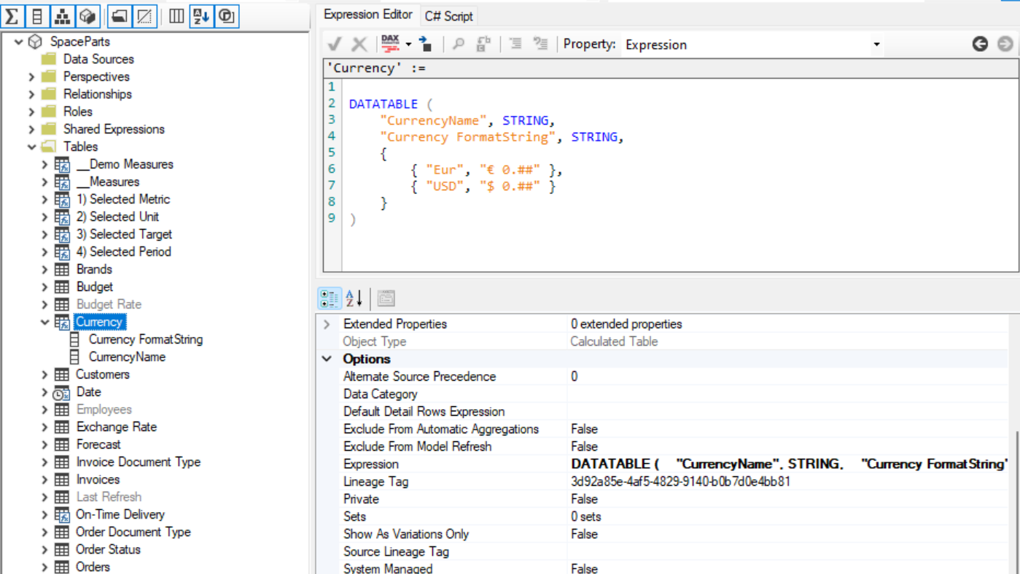
Example: Calculated Table
Looks like a table with no partition and an “Expression” property
Table (object)
Expression (string property)

Slide 38
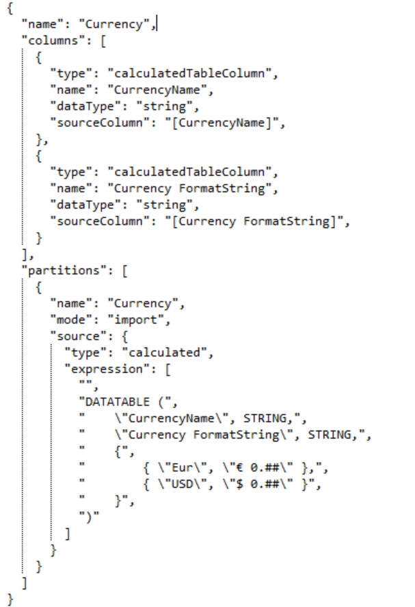
…but in TOM, things are more complex
Table (object)
Partition (object)
Partition Source (object)
Expression (string property)

Slide 39
Why simplify?
Calculated tables must have exactly 1 partition
That partition must always:
Be in import mode
Use a calculated partition source, whose “Expression” property must be a valid DAX table expression
If you can’t tweak or tune it, Tabular Editor won’t show it
Advanced users can still access the TOMWrapper Partition object through C# scripts
Notes:
Show demo on how to access the Partition object of a calculated table:
Selected.Table.Partitions.Output();

Slide 40
Intermezzo: I bet you haven’t heard about…
The Tabular Object Model contains many exotic objects and properties. Such as:
Variations?
Sets?
Detail Rows?
Column Alignment?
Notes:
Variations are rarely set up manually. Power BI uses them for the automatic date/time tables, enabling DAX syntax like: Table[Date].[Month]
Sets are created automatically by Desktop, typically only in DirectQuery models over SAP Business Warehouse / SAP HANA data sources
Detail Rows can be consumed in Excel or other client tools capable of performing a drill-through at the cell level (measure) – Power BI, notably, does not support this
Column Alignment seems to have no effect when applied in neither Desktop or Excel. Perhaps other client tools (SSRS, Targit, etc.) may benefit.

Slide 41
Demo
Advanced TOM objects and properties
Notes:
A quick demo that shows how to set up:
DetailRows on tables / measures
Variations
Advanced Model Options

Slide 42
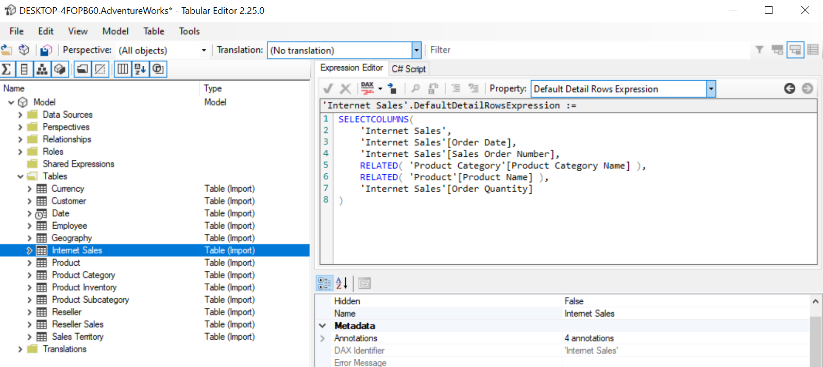
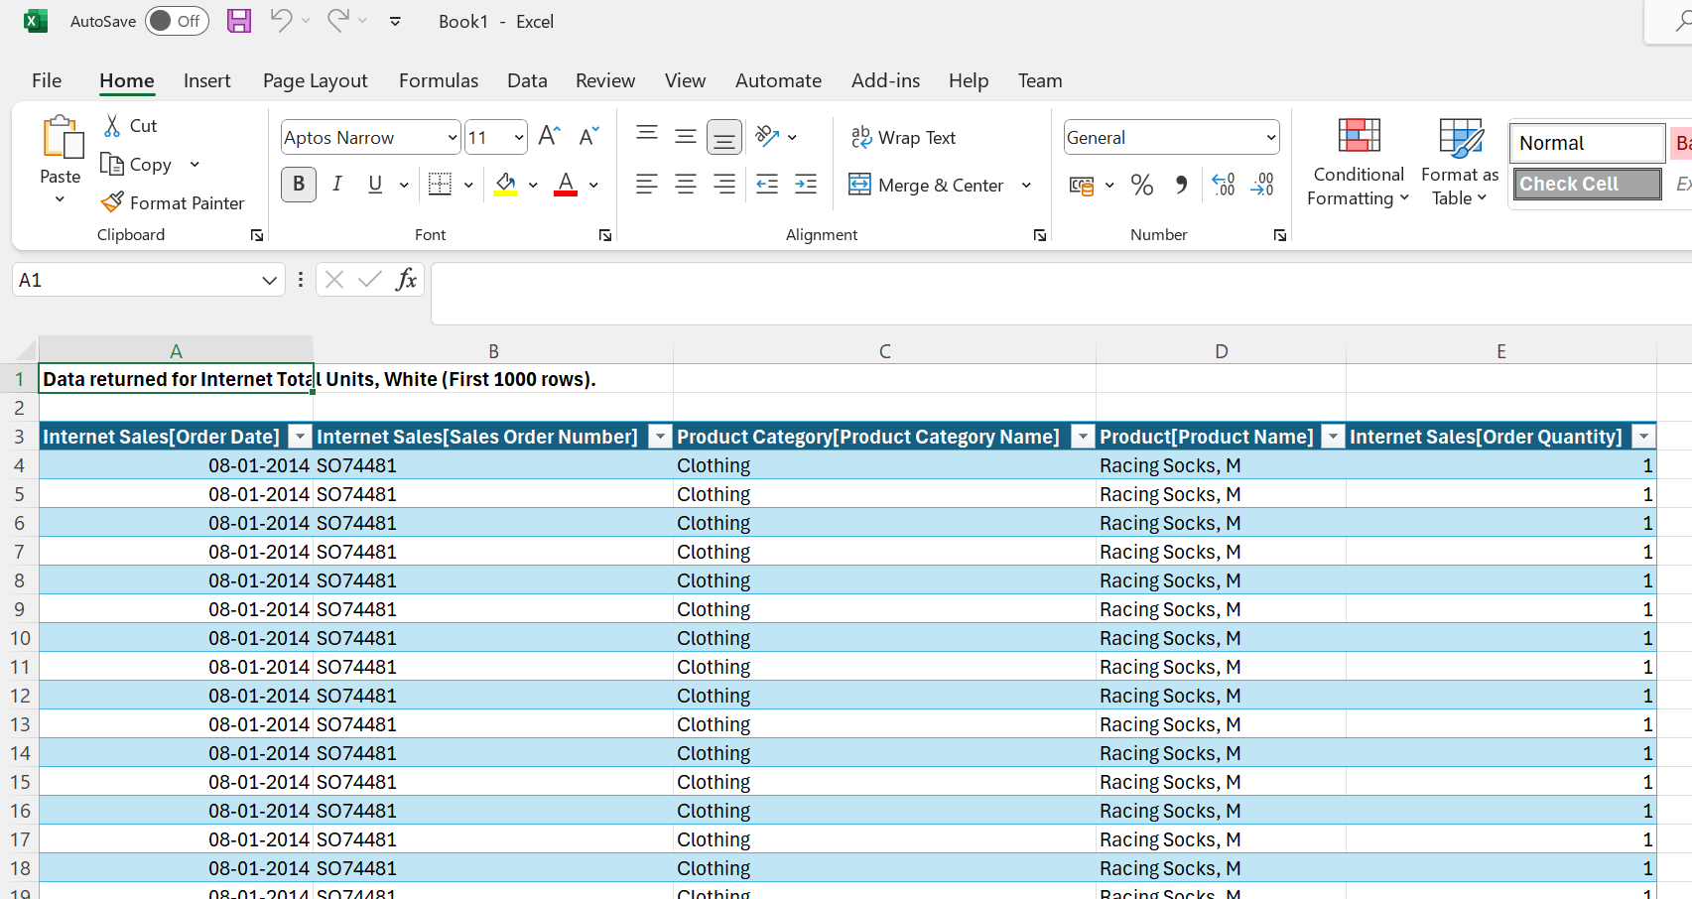
Detail rows
Used by Excel for drill-through in Pivot Tables
Detail Rows Expressions can be used to specify a table expression to return when doing a drill-through
Detail Rows Expressions can be defined
At the table level (will impact all measures on that table)
At the measure level (will impact just that measure)
You can refer to existing Detail Rows Expressions using DETAILSROWS( <Measure> )
Notes:
More on TOM Exploration with Tabular Editor

Slide 43
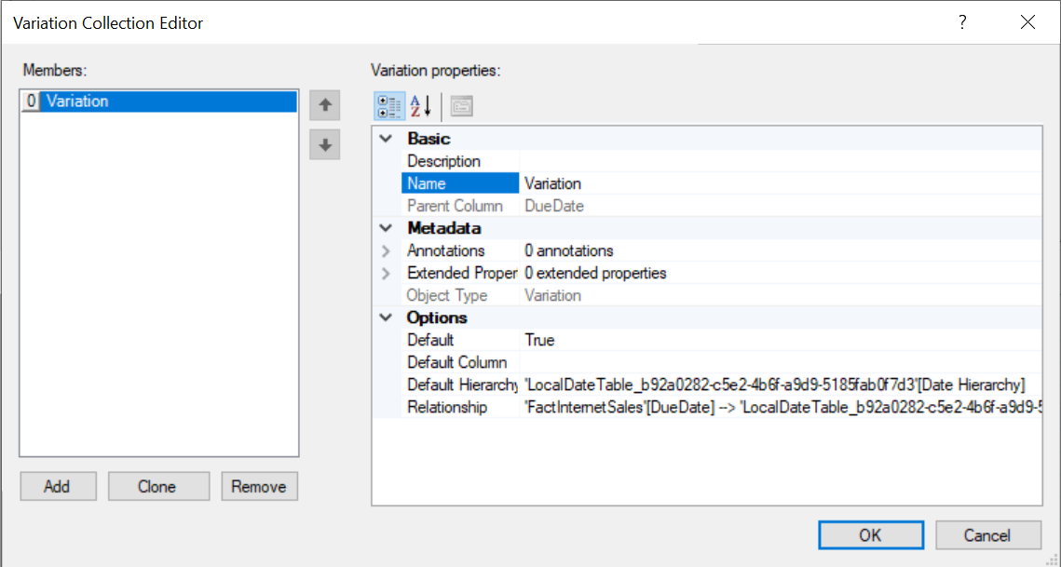
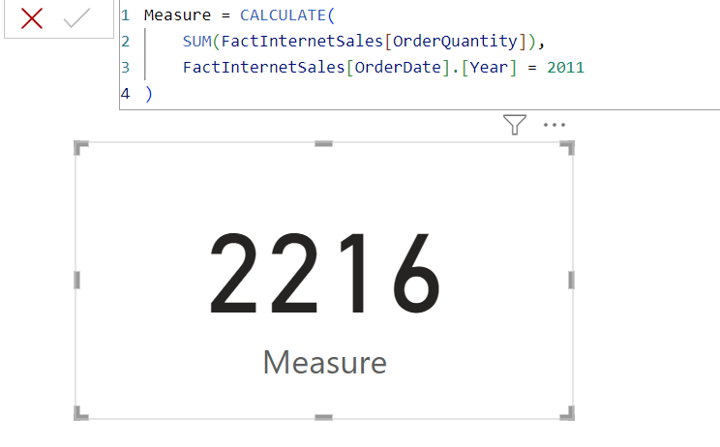
Variations
Used by auto Date/Time in Power BI Desktop
Allows special DAX syntax for accessing hierarchies through relationships
even when the table on which the hierarchy exists is hidden / private
TBH, not sure what the benefit is, since you could already access hidden / private tables with DAX…
Notes:
More on TOM Exploration with Tabular Editor

Slide 44
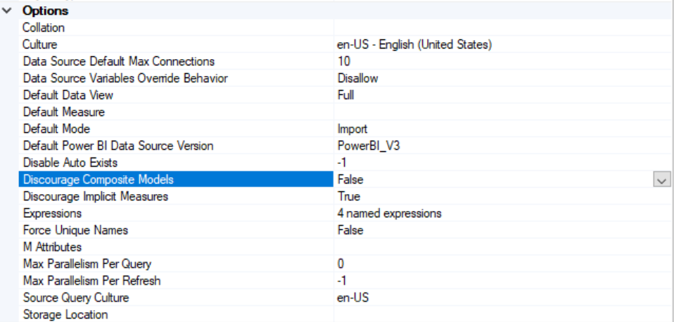
Advanced model options

Slide 45



C# scripting with Tabular Editor
Unlock the full potential of your semantic models with C# scripts

Slide 46
C# script introduction

Slide 47
Why scripts?
Impossible to cater to every possible use case
Scripts provide ultimate flexibility for things like:
Automation
Documentation
Advanced workflows
Applying best practices
Advantage of Tabular Editor scripts
View impact of script immediately in the TOM Explorer
Semantic model isn’t modified until you hit the Save button
Undo script execution by hitting Ctrl+Z
Write reusable scripts that take current TOM Explorer selection into account
Write scripts with user interaction, with/without custom UI elements
Save scripts as macros which integrate nicely with Tabular Editor’s UI

Slide 48
Demo
C# scripts and macros
Notes:
Show the “add time intelligence” demo – save as a macro and execute

Slide 49
Why C#?
Tabular Editor is written in C#
AMO/TOM is written in C#
.NET is a huge ecosystem of utility functions and libraries
C# is fun and easy to learn

Slide 50
Script architecture
Scripts interact with TOMWrapper, not AMO/TOM
Ensures change tracking, enabling Undo/Redo functionality
Direct access to TOMWrapper helper methods and properties, not available in TOM, for example:
Table.AddMeasure(…)
Measure.ReferencedBy
Column.TranslatedNames["da-DK"] = …
Tabular Editor script API for additional functionality
Interacting with the current selection in TOM Explorer
Showing information to the user
Prompting the user to select an object
Formatting DAX
Executing DAX queries*
Exporting / importing object properties
System.Windows.Forms for custom UI
Currently, no support for direct interactions with the Tabular Editor UI
Load / Save / Deploy current model, run BPA, etc.
C# script
Tabular Editor script API
Tabular Editor UI
TOMWrapper
System.Windows.Forms
AMO/TOM
*Only when connected to an instance of AS

Slide 51
C# crash course
C-like syntax
curly braces to enclose scopes { … }
all statements must end with ;
// line comments
/* … block comments … */
case-sensitive
whitespace (including line breaks) is ignored
all keywords are lowercase
= (single equal sign) for assignments
== (double equal sign) for comparisons
Ternary operator: <condition> ? <if_true> : <if_false>

Slide 52
C# crash course
Primitive types:
int, decimal, double, bool, DateTime, string
Variable assignment:
var result = 1 + 2;
Method call:
Info("Hello world!");
Enums:
enum Gender { Female, Male, Other }
Objects (can contain fields and methods)
class Person { public string Name; public DateTime BirthDate; public Gender Gender; public int GetAge() { return (int)((DateTime.Now - BirthDate).TotalDays / 365.2425); } } var person1 = new Person { Name = "Daniel", BirthDate = new DateTime(1984, 12, 21), Gender = Gender.Male };

Slide 53
C# crash course
C# strings
Defined using " (double quotes)
\ (backslash) is the escape character
\" inserts a double-quote in the string
\r\n inserts a line break
\t inserts a tab
C# verbatim strings
Defined using @" (at sign + double quote)
Allows strings to span multiple lines of code, preserving line breaks
No backslash escape – instead escape double quotes by repeating them: "“
string.Format(string format, params object[] args)
Used to insert values into string placeholders. Placeholders are denoted with: {0}, {1}, {2}, etc.
Since we also use curly braces in DAX, we sometimes need to escape with double-curlys: {{ \"{0}\" }}
string.Join(string separator, IEnumerable<string> args)
Useful when you need to concatenate multiple strings into one
Interpolated strings, $"Hello {name}", not supported in C# scripts in TE2
Unless you specify a custom C# compiler: https://docs.tabulareditor.com/te2/Advanced-Scripting.html#compiling-with-roslyn

Slide 54
C# crash course
Member access:
Info(person1.Age);
Built-in collections and generics:
var people = new List<Person>{ person1, person2, person3 };
var peopleByName = new Dictionary<string, Person>(); peopleByName.Add(person1.Name, person1); peopleByName.Add(person2.Name, person2);
Access by index:
people[0].GetAge();
peopleByName["Daniel"].GetAge();

Slide 55
C# crash course
Common control flow constructs:
if ( <condition> ) { ... } else if ( <condition> ) { ... } else { ... }
for (var i = 0; i < 10; i++) { ... }
foreach (var item in collection) { ... }
while ( <condition> ) { ... }
do { ... } until ( <condition> )
switch ( <expression> ) { case <value1>: ...; break; case <value2>: ...; break; default: ...; break; }

Slide 56
C# crash course
Object inheritance:
class Developer: Person { public string PreferredLanguage; public List<string> KnownLanguages; }
class Manager: Person { public List<Person> Team; }
Type checks and type casts:
if (person1 is Developer) { var dev1 = (Developer)person1; Info(string.Format("{0} knows {1} languages", dev1.Name, dev1.KnownLanguages.Count)); }

Slide 57
C# crash course
LINQ – insanely useful for working with collections
var averageMaleAge = people.Where(p => p.Gender == Gender.Male) .Average(p => p.Age);
.OfType<T>()
.FirstOrDefault(p => p.Age >= 39)
.Select(p => p.Name)
(+ many other extension methods)
Lambdas are just short-hand notations for methods
p => p.Gender == Gender.Male
…is equivalent to…
bool IsMale(Person p) { return p.Gender == Gender.Male; }

Slide 58
C# in Tabular Editor
Tabular Editor provides a special “API” for C# scripts
Top-level objects:
Model
The root of the Tabular Object Model (as represented by TOMWrapper)
Selected
The currently selected object/objects in Tabular Editor’s TOM Explorer UI
Helper methods:
Info(<string>);
Warning(<string>);
Error(<string>);
Output(<primitive, object or collection>); / <primitive, object or collection>.Output();
SelectColumn(<columns>, <pre-selected>, <label>);
SelectMeasure(<measures>, <pre-selected>, <label>);
SelectTable(<tables>, <pre-selected>, <label>);
(And many more… we’ll get back to that)

Slide 59
Differences between TE2 and TE3
TE2 scripts generally work on TE3
If you encounter a C# script that works in TE2, but not in TE3, please let us know: support@tabulareditor.com
TE3 has a few public API features that do not work with TE2
TE2 scripts are compiled using the CodeDomProvider in .NET Framework 4.8
supports C# language features up to C# 5 (no support for interpolated strings ☹)
Possibility to specify custom C# compiler (for example if you have Visual Studio installed)
TE3 scripts are compiled using Roslyn
support for all C# language features up to C# 10
Use pre-processor directives if you must: #if TE3 // ... code that requires TE3 ... #else // ... code that requires TE2 ... #endif
For custom C# applications, use TOMWrapper.dll from TE2 (MIT license)
TOMWrapper.dll (and any other file) from TE3 is commercially licensed

Slide 60
C# script exercises
“Hello world!”
Basic model stats
Output selection details
Create system measure
Create SUM measures from columns
(Advanced) Custom UI
Notes:
If you’re used to working with Tabular Editor scripts, you may want to skip exercise 1-5 and go straight to exercise 6, which will guide you through the creation of a C# script that uses custom UI.

Slide 61
Exploring Tabular Editor’s scripting API

Slide 62
Recap
Previous section introduced C# scripting in Tabular Editor
Top-level objects:
Model
Selected
Helper methods for showing messages or interacting with the user
But Tabular Editor’s scripting API can do much more…

Slide 63
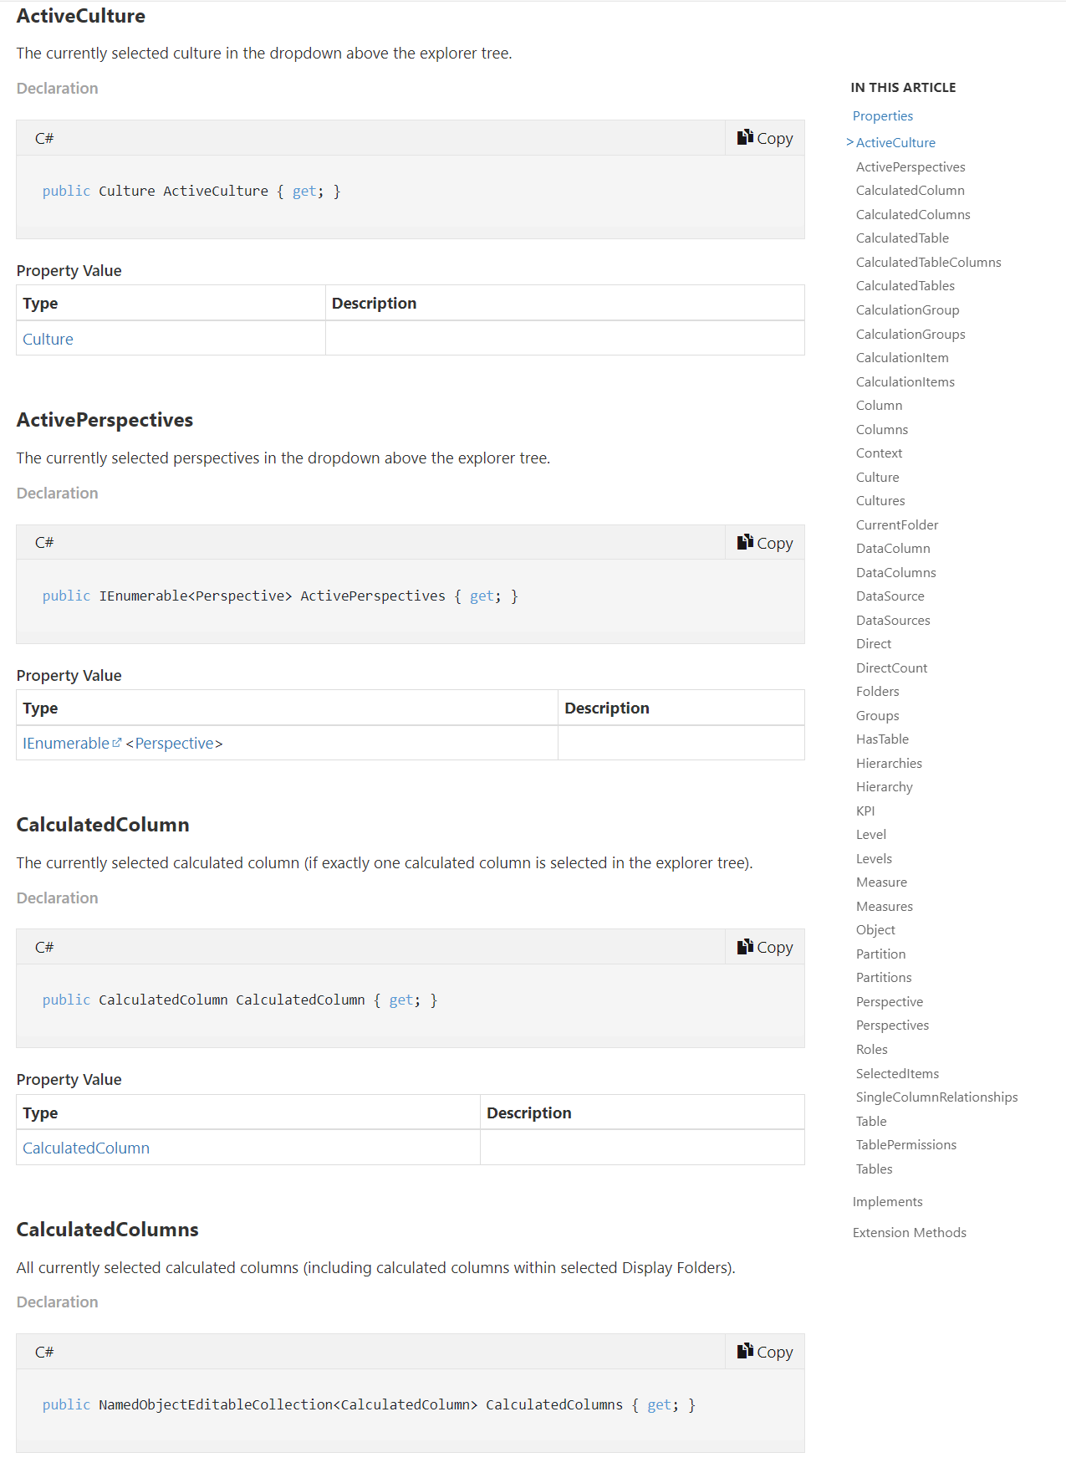
What’s “Selected”?
Cornerstone of reusable C# scripts
Contains many properties that make it easy to examine selections of specific object types
Singular property names (Measure, Column, etc.)
Returns the currently selected item if, and only if, exactly 1 such item is selected – throws error otherwise
Plural property names (Measures, Columns, etc.)
Returns a collection of all selected such items. If none are selected, the collection is empty.
Subtypes, so you don’t need explicit casts, i.e.
CalculatedTables
CalculatedColumns
CalculationGroupTables
SingleColumnRelationships
Notes:
We’ve already seen a few examples of helper methods in Tabular Editor’s scripting API

Slide 64
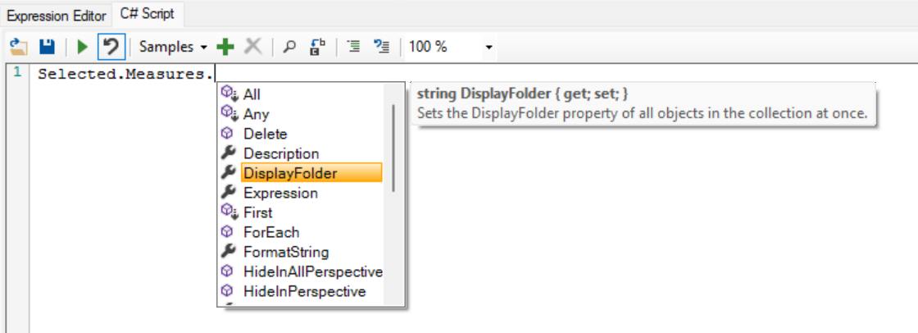
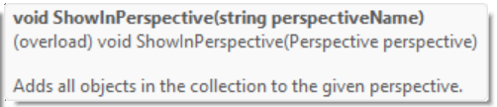
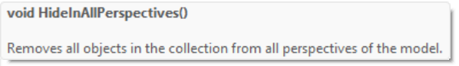
What’s “Selected”?
Selected collections have property getters/setters
Shortcut to set the property value on all items in the collection at once
Getting the property value on all items at once returns null unless all items have the same property value
Selected collections have extension methods for:
Renaming items in the collection (string replace or RegEx)
Performing string replace in the Expression property of all items*
Show/hide selected items in a specific perspective**
Show/hide selected items in all perspectives**
Delete all items from the model
* = Only on items that have an Expression property (Measures, Calculated Columns, etc.)
** = Only on items that can be added to partitions (Tables, Columns, Measures, Hierarchies)

Slide 65
Pop quiz
How many lines of code would you need, for a script that:
For every selected measure…
…unhides it (i.e. IsHidden = false);
…sets its FormatString to "0.00“
…replaces any occurrence of the word “red” to “blue” in the measure expression
Answer: 3
Selected.Measures.IsHidden = false; Selected.Measures.FormatString = "0.00"; Selected.Measures.ReplaceExpression("red", "blue");

Slide 66
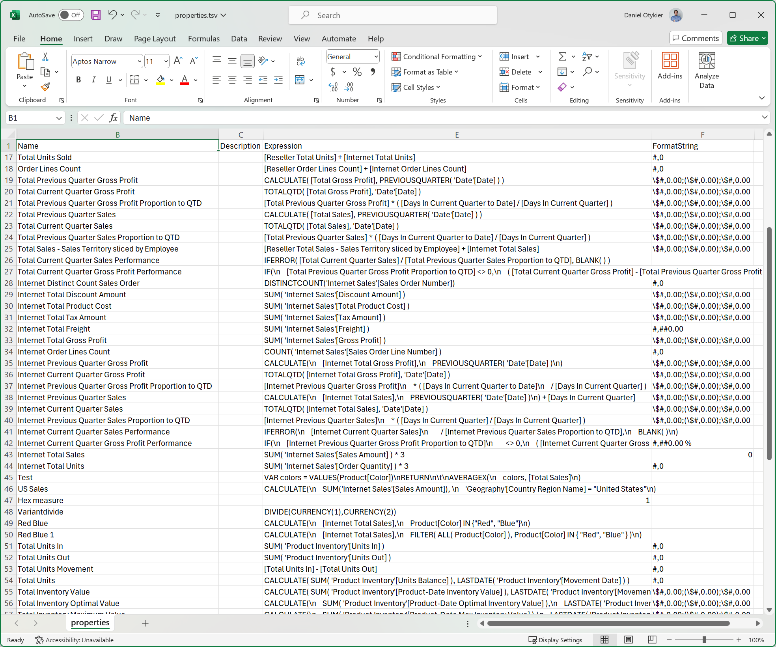
File IO and metadata roundtrip
Convenient methods for reading/writing text from/to files:
string ReadFile(string path)
void SaveFile(string path, string content)
(Of course, you can also use .NET System.IO if you prefer)
What if you wanted to batch edit object properties in Excel?
string ExportProperties(<collection>, <properties>)
void ImportProperties(string)
Notes:
ExportProperties / ImportProperties uses a tab separated values (tsv) format. The first column in the tsv is a special identifier for the object, obtained through the string GetObjectPath(object) method. ImportProperties uses the ResolveObjectPath(string) method to locate a TabularObject in the model tree, based on a path returned by GetObjectPath

Slide 67
Querying Analysis Services
EvaluateDax(string dax)
Gets a .NET DataTable when <dax> is a DAX table expression
Gets a .NET primitive object (string / DateTime / long / etc.) when <dax> is a DAX scalar expression
ExecuteDax(string query)
Assumes <query> is a DAX query, an MDX query or a DMV query.
Returns a .NET DataSet containing the result of executing the query
ExecuteReader(string query)
Assumes <query> is a DAX query, an MDX query or a DMV query.
Returns a .NET IDataReader which can be used to iterate through the results of the query
ExecuteCommand(string tmslOrXmla, bool isXmla = false)
Executes a TMSL or XMLA command (for example, to perform a refresh operation)
Use cases:
Dynamically generating measures, calculated column expressions, or other metadata based on actual data
Simple unit testing
Note: All these methods are synchronous and blocking
I.e. the query or command that gets executed must complete before the script can continue execution.
In case of an error, the methods throw an exception, which can be handled in a suitable try { … } catch { … } block

Slide 68
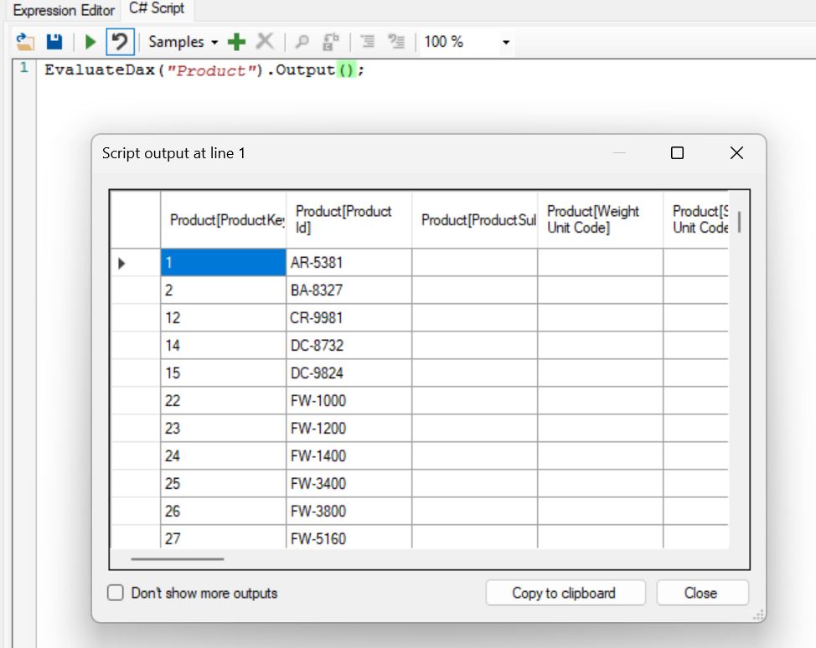
Outputting / debugging script
Output(…) very versatile
Useful when debugging scripts
Can display primitive values
Can display TOM objects (property grid)
Can display collections/lists of values
Can display collections/lists of TOM objects
Can display .NET DataTable data (such as returned from the EvaluateDax(<string>) method)
Can also be used as an extension method on any object, i.e. object.Output()

Slide 69
Outputting / debugging script
throw new Exception("An error occurred");
Halts script execution and displays the error message and line number
Error("An error occurred");
Displays the error message and line number, but doesn’t halt script execution
Warning(string) / Info(string)
Same as Error(string) but with a different icon in the message box
When script is executed through Tabular Editor CLI, Error(…), Warning(…), and Info(…) causes different logging messages equivalent to their respective severities

Slide 70
Formatting DAX
FormatDax() extension method
Flags object for formatting only.
Flagged objects are formatted after the script finishes execution.
Force formatting during script execution by calling CallDaxFormatter()
FormatDax(<object-list>, <short-format>, <skip-space-after-function>)
Immediately formats specified objects
Note: TE3, by default, performs the formatting offline where as TE2 performs a web request to www.daxformatter.com (since TE2 does not have a built-in formatter)
ConvertDax(<dax>, <use-semicolons>)
Can be used to convert DAX between US and non-US locales

Slide 71
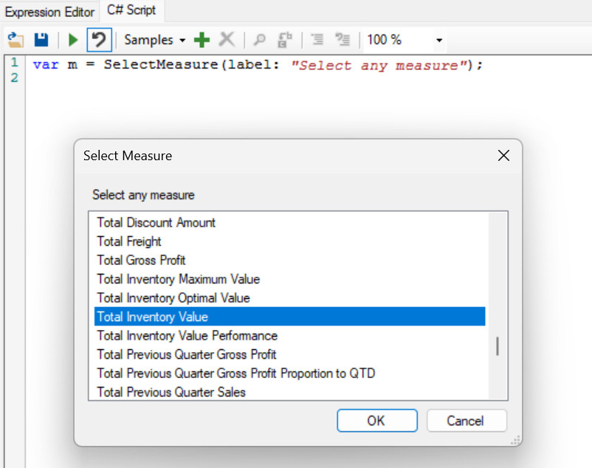
Prompting the user
1-liner to show a list of TOM objects to the user, prompting them to select one
SelectTable(…)
SelectColumn(…)
SelectMeasure(…)
SelectObject<T>(…)
Identical syntax:
1st argument: Items to show in the list (if omitted, shows all objects in the model)
2nd argument: Item to preselect (omit/null to not preselect any)
3rd argument: Label to show above the list

Slide 72
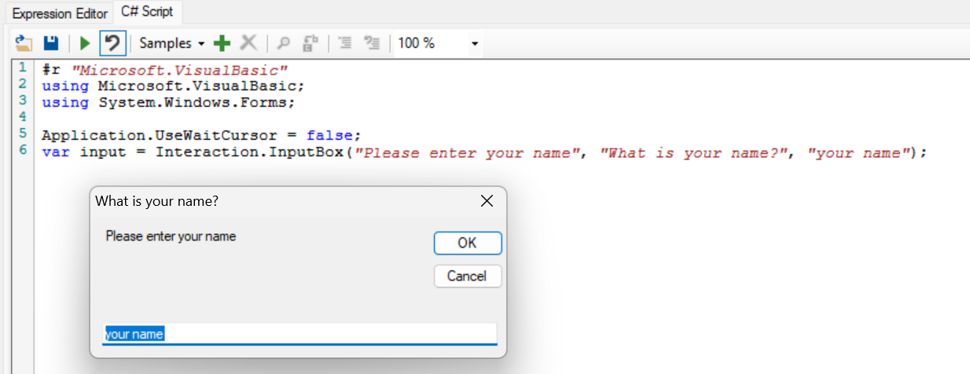
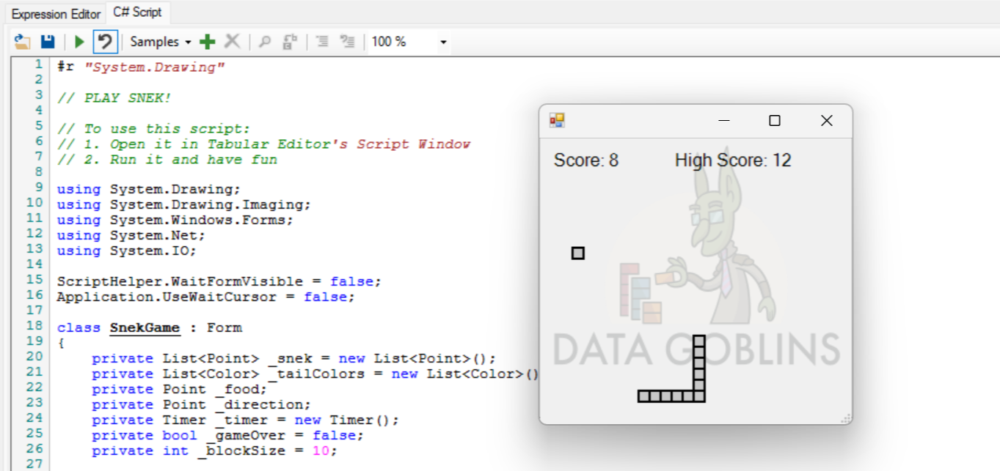
Prompting the user
To prompt the user for a string input, you can use Interaction.InputBox from Microsoft.VisualBasic namespace
For more complex UI, use System.Windows.Forms (WinForms)
See Exercise 1.6
Caution: Use Form.ShowDialog() to halt script execution while your custom UI is showing.
Notes:
Custom UI demo - show the difference between:
using System.Windows.Forms;
var f = new Form{ Text = "Hello from custom UI" };
f.Show();
Info("Script completed!");
---- and -----
using System.Windows.Forms;
var f = new Form{ Text = "Hello from custom UI" };
f.ShowDialog(); Info("Script completed!");

Slide 73
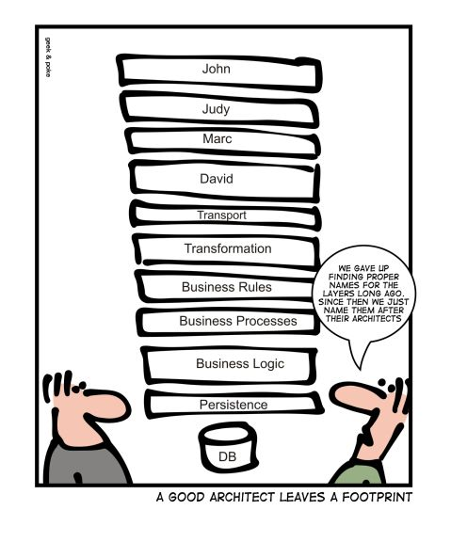
TOMWrapper recap
An abstraction layer on top of AMO/TOM
Change tracking (required for undo/redo)
Convenient extensions
Table.AddMeasure(…)
Measure.ReferencedBy …
TOMWrapper principles that differ from AMO/TOM:
Don’t directly instantiate TOM objects (use the Add***-method on the parent object)
Don’t manually insert TOM objects in the TOM tree (handled by the Add***-methods as well)
Don’t manually remove TOM objects from the TOM tree (handled by the Delete() method)
For new objects: All properties initialized to their default values
For new tables: 1 partition added by default

Slide 74
TOMWrapper object hierarhcy
TOMWrapper mostly uses the same type names for TOM objects, as AMO/TOM
Base objects differ:
MetadataObject -> TabularObject
NamedMetadataObject -> TabularNamedObject
TOMWrapper mostly uses the same property names, as AMO/TOM

Slide 75
TOMWrapper interfaces
TOMWrapper makes wide use of interfaces (which AMO/TOM doesn’t), for example:
IDaxObject: Objects that can be referenced in DAX expressions on other objects
IDaxDependantObject: Objects that can depend on one or more IDaxObjects through DAX expressions
IClonableObject: Objects that can be duplicated directly in the TOM tree
ITranslatableObject: Objects that support metadata translations for their Name and Description properties
IDescriptionObject: Objects that have a Description property
IFolderObject: Objects that can be present in a Display Folder
IExpressionObject: Objects that have an Expression property
IHideableObject: Objects that have an IsHidden property
IAnnotationObject: Objects that support annotations
IExtendedPropertyObject: Objects that support extended properties
ILineageTagObject: Objects that have the LineageTag property
ITabularObjectContainer: Objects that may contain other TOM objects
Interfaces make it easier to work with objects that support certain operations, rather than being of a particular type
foreach(var obj in Selected.OfType<IDescriptionObject>()) { if(obj is IExpressionObject) obj.Description = "The expression on this object is: " + (obj as IExpressionObject).Expression; }

Slide 76
IDaxDependantObject
A number of extension methods exist, specifically for objects that have one or more DAX properties
Measures (Expression, FormatStringExpression, DetailRowsExpression)
Calculated Columns / Calculated Tables / Table Permissions (Expression)
Calculation Items (Expression, FormatStringExpression)
KPIs (StatusExpression, TargetExpression, TrendExpression
etc.
These extension methods lets you:
Enumerate the DAX properties on an object (GetDaxProperties())
Get or set the DAX expression of a given property (GetDAX() / SetDAX(…))
Tokenize the DAX expression

Slide 77
Tokenize the DAX expression?!?
No, this has nothing to do with LLMs or CoPilot ☺
“Tokenization”, in this context, is just the process of converting a string representation of a DAX expression into a list of “tokens” representing keywords, functions, symbols, etc.
It’s a prerequisite to parsing the code (which TE2 doesn’t do, btw)
Example:
// Total number of units sold: SUM('Internet Sales'[LineQuantity])
Used by Tabular Editor’s Formula Fix-up and Dependency Detection
Can be used in custom BPA rules to avoid complex RegEx (i.e. RegEx that has to take whitespace and comments into account)
Token type | From | To | Text
SINGLE_LINE_COMMENT | 0 | 30 | // Total number of units sold
WHITESPACES | 31 | 31
SUM | 32 | 34 | SUM
OPEN_PARENS | 35 | 35 | (
TABLE | 36 | 51 | Internet Sales
COLUMN_OR_MEASURE | 52 | 65 | LineQuantity
CLOSE_PARENS | 66 | 66 | )

Slide 78
Tabular Editor script API exercises
Apply default properties
Formatting DAX
“Can I export this to Excel?”
Parameter table
Data-driven metadata generation
(Advanced) The Tokenizer

Slide 79
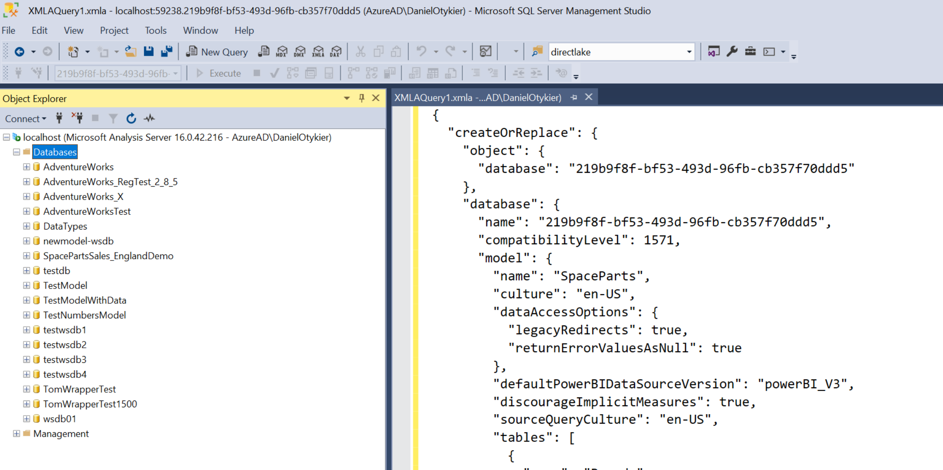
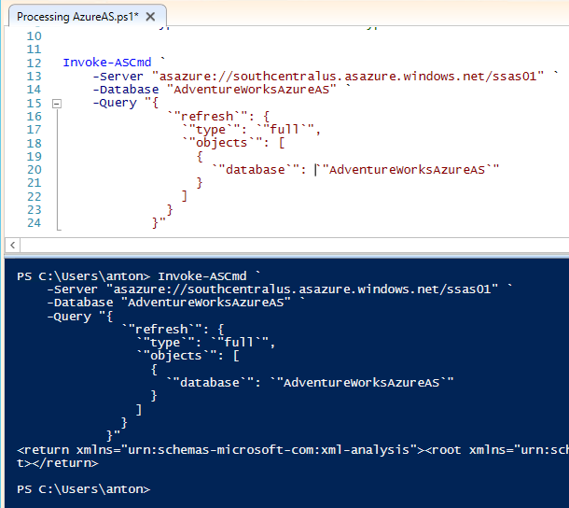
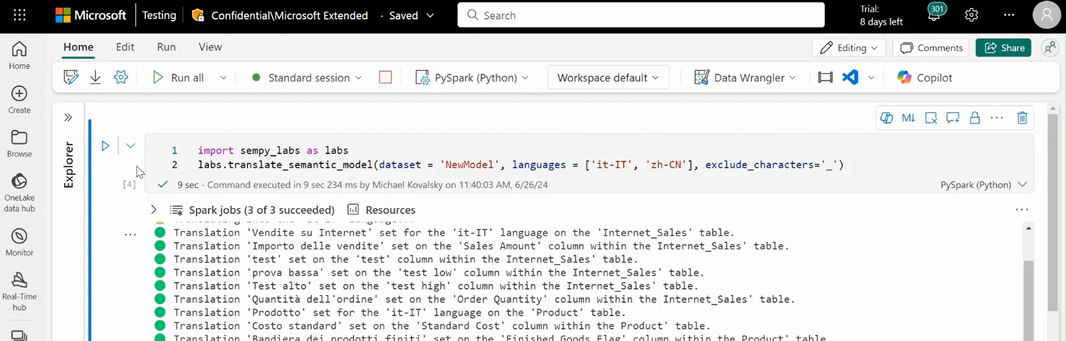
TOM Exploration using other tools

Slide 80
Other tools
SSMS
Notepad(!!!)
AMO/TOM + VS Code / Visual Studio
PowerShell
Fabric Notebook: Semantic Link Labs
https://www.linkedin.com/pulse/semantic-modeling-without-third-party-tools-daniel-otykier-okr8f/

Slide 81
SSMS
SQL Server Management Studio – 1st party offering from Microsoft
Connects to AS / PBI using AMO
Execute DAX, MDX, DMV queries and TMSL “DML” scripts
Cons:
No automation
TMSL scripts won’t work against Power BI Desktop (must rely on raw XMLA which is horrible)

Slide 82
Notepad
Edit TMSL “DDL” (Model.bim) files and TMDL
Useful with Power BI Desktop “Developer Mode” aka. “Power BI Projects”
Cons:
No validation of model metadata
No automation

Slide 83
AMO/TOM + VS Code / Visual Studio
Closing thing to C# scripting in Tabular Editor
…but without all the goodness of TOMWrapper
Many examples can be found online
Cons:
Requires dev tool installations
Higher learning curve than C# scripts in Tabular Editor

Slide 84
PowerShell
Invoke-AsCmd
Official cmdlet that allows execution of scripts (XMLA / TMSL) and queries
Can load .NET dll’s, such as AMO/TOM
But at that point, you’re probably better off using VS Code / Visual Studio
Many examples online

Slide 85
Fabric Notebook: Semantic Link Labs
New kid on the block! Semantic modelling with Python
Semantic Link Labs is an open-source module maintained by Microsoft
Contains a lot of the same functionality as TOMWrapper:
Convenience methods / extensios
BPA
Cons:
Only works for semantic models in Microsoft Fabric

Slide 86
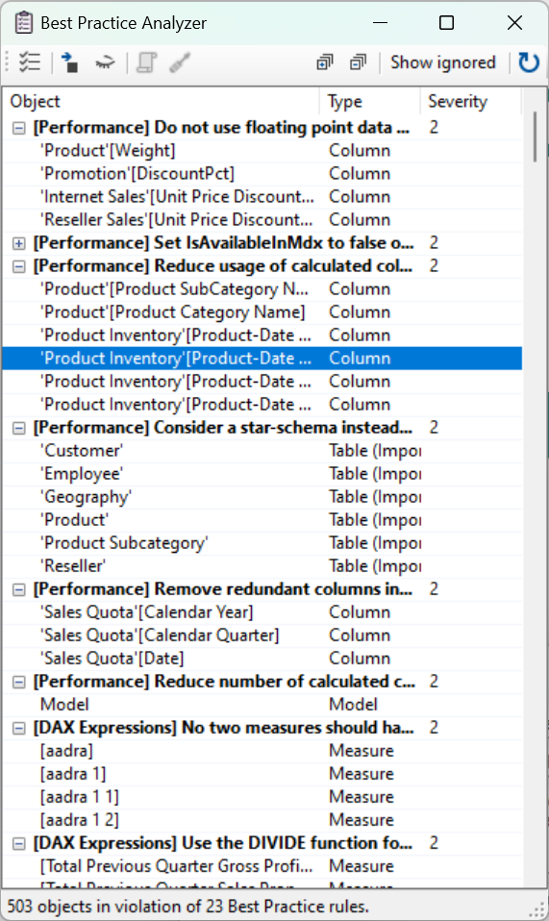
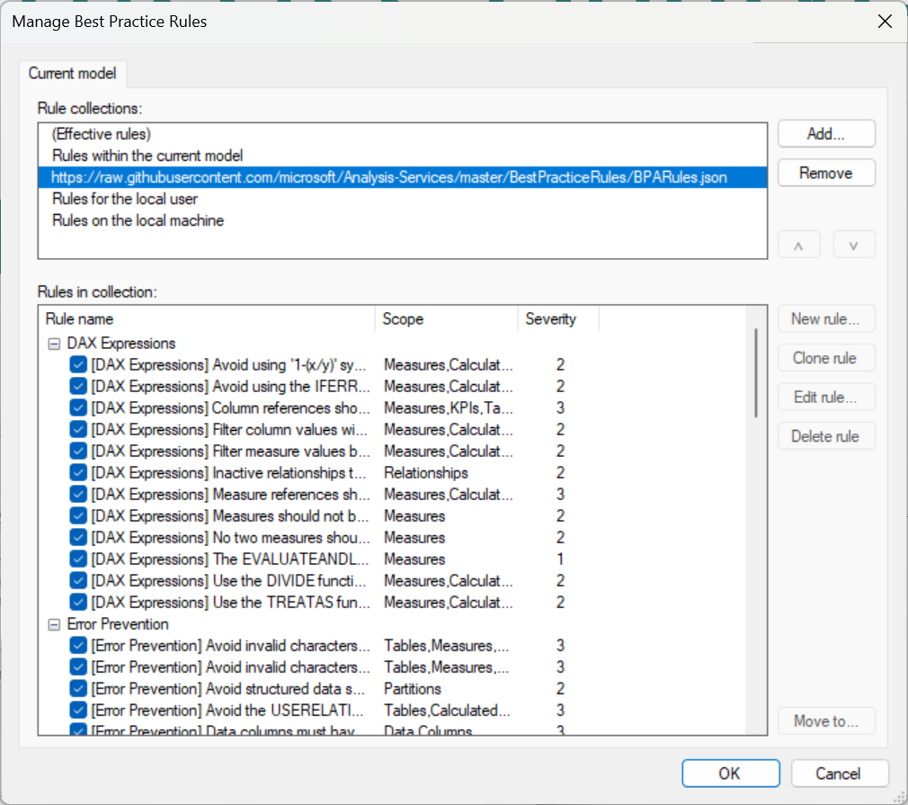
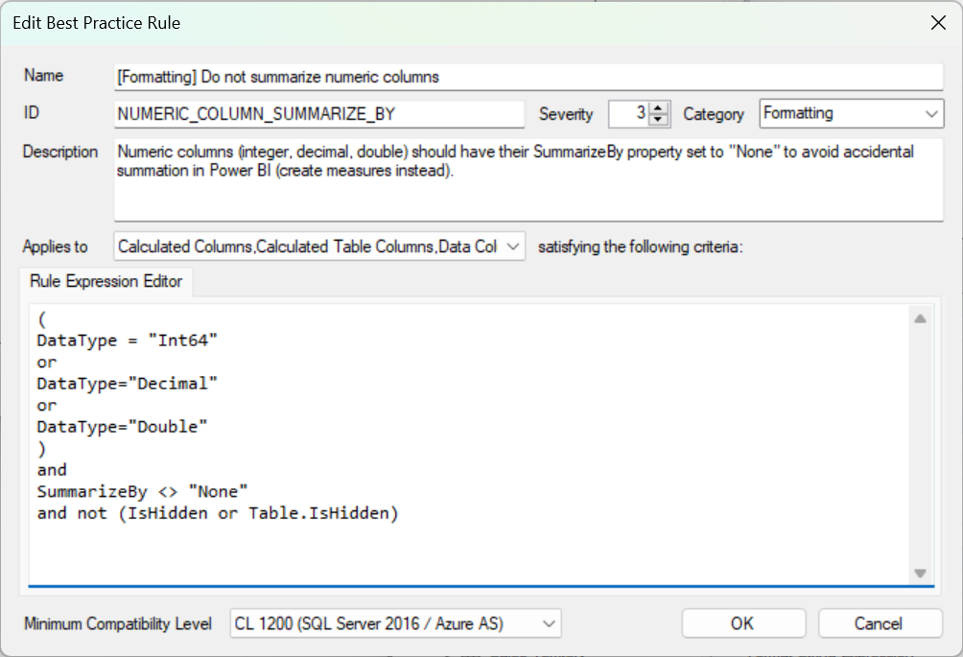
Best Practice Analyzer and custom rules

Slide 87
Best Practice Analyzer
A feature of TE2 and TE3, that scans your model metadata for certain anti-patterns, while you work
Best Practice rules are completely customizable
No rules included out-of-the-box, but good starting point can be found here:
https://powerbi.microsoft.com/en-us/blog/best-practice-rules-to-improve-your-models-performance/ by Michael Kovalsky @ MSFT Fabric CAT
Semantic Link Labs (plug-in for Fabric Notebooks) nowadays also support scanning your models for Best Practice violations
https://github.com/microsoft/semantic-link-labs?tab=readme-ov-file
Best Practice rule definitions ported to Python by Michael Kovalsky @ MSFT Fabric CAT

Slide 88
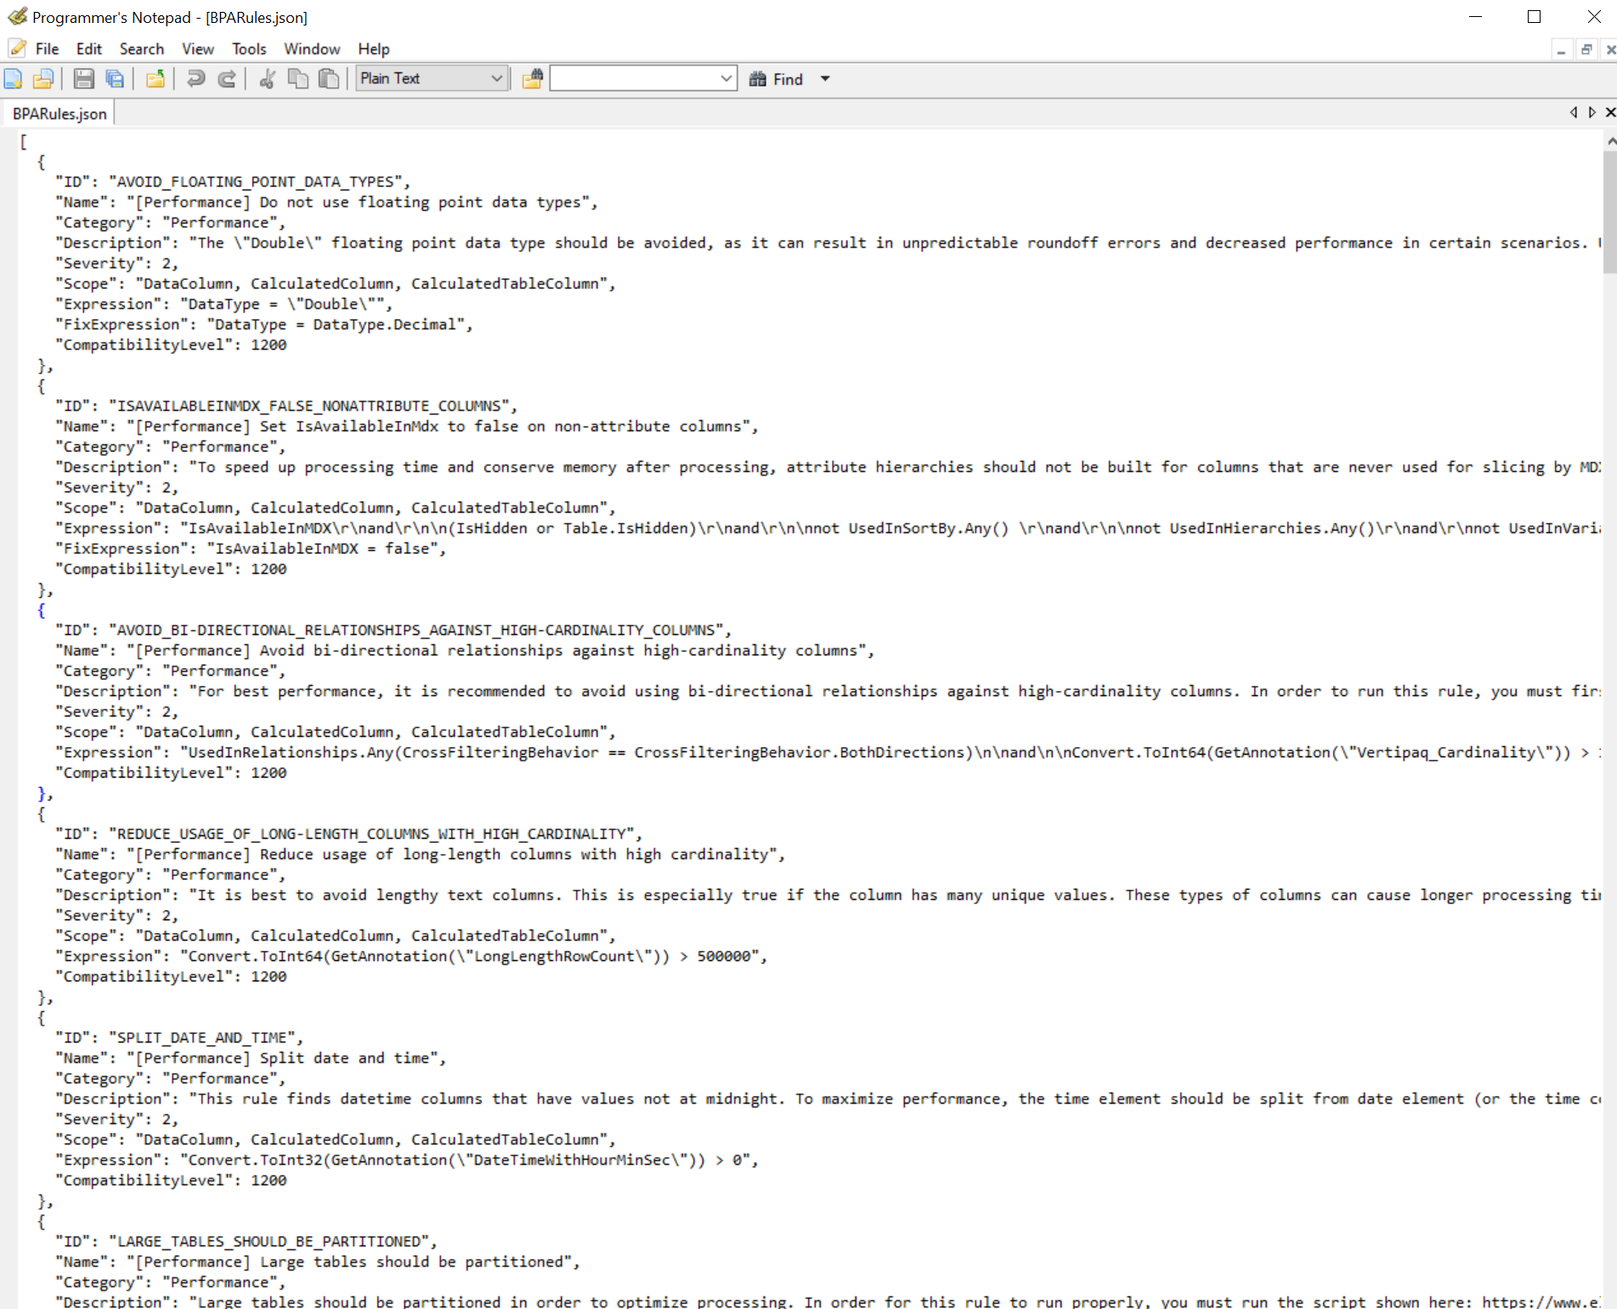
Best Practice rule definitions
Rule definitions stored in JSON
%LocalAppData%\TabularEditor\BpaRules.json
Each rule must specify:
ID (string) – must be unique
Name (string) – displayed to the user
Description (string, optional) – additional details about the rule
Category (string, optional) – provides a way to group rules that deal with similar aspects of the semantic model
Severity (int) – 1: Low, 2: Medium, 3: High
CompatibilityLevel (int) – minimum compatibility level that the model must be, before the rule is applicable
Expression (string) – Dynamic LINQ expression specifying which objects to flag as being in violation of the rule (more details later)
FixExpression (string, optional) – A C# snippet that provides a way to assign a value to an object property, in order to fix the rule violation

Slide 89
LINQ and Lambdas
Many LINQ function in C# lambdas
Recap: A lambda is just a short-hand notation for defining a method
// Method syntax: string GetTableName(Table table) { return table.Name; }
// Equivalent Lambda syntax: t => t.Name;
Lambdas are handy for projections and predicates – which is the majority of parameters used by LINQ functions…
Model.Tables.Where(t => t.Name.StartsWith("dim")).OrderByDescending(t => t.Columns.Count).First();
string.Join(", ", Model.AllMeasures.Select(m => m.Name))
Model.Tables.Any(t => t is CalculationGroupTable)

Slide 90
LINQ and Lambdas
…so handy, in fact, that we based the expression language of Tabular Editor’s Best Practice Analyzer, on LINQ-like syntax (called Dynamic Linq)
But with implicit Lambdas!
Finding “implicit measures” in C# | Finding “implicit measures” with BPA Scope = Columns
Model.AllColumns.Where(c => ( c.DataType == DataType.Int64 || c.DataType == DataType.Decimal || c.DataType == DataType.Double) && c.IsVisible && c.SummarizeBy != AggregateFunction.None ) | (DataType = "Int64" or DataType = "Decimal" or DataType = "Double") and IsVisible and SummarizeBy <> "None"

Slide 91
Fix expressions
Sometimes, fixing a rule violation is just a matter of setting a single property
Example:
column.SummarizeBy = AggregationType.None;
In such cases, Tabular Editor’s BPA provides a way where a BPA rule can specify the C# statement required to fix the issue
BPA then generates the full C# script needed to fix the issue for the selected objects

Slide 92
Demo
Best Practice Analyzer, Dynamic LINQ and FixExpressions

Slide 93
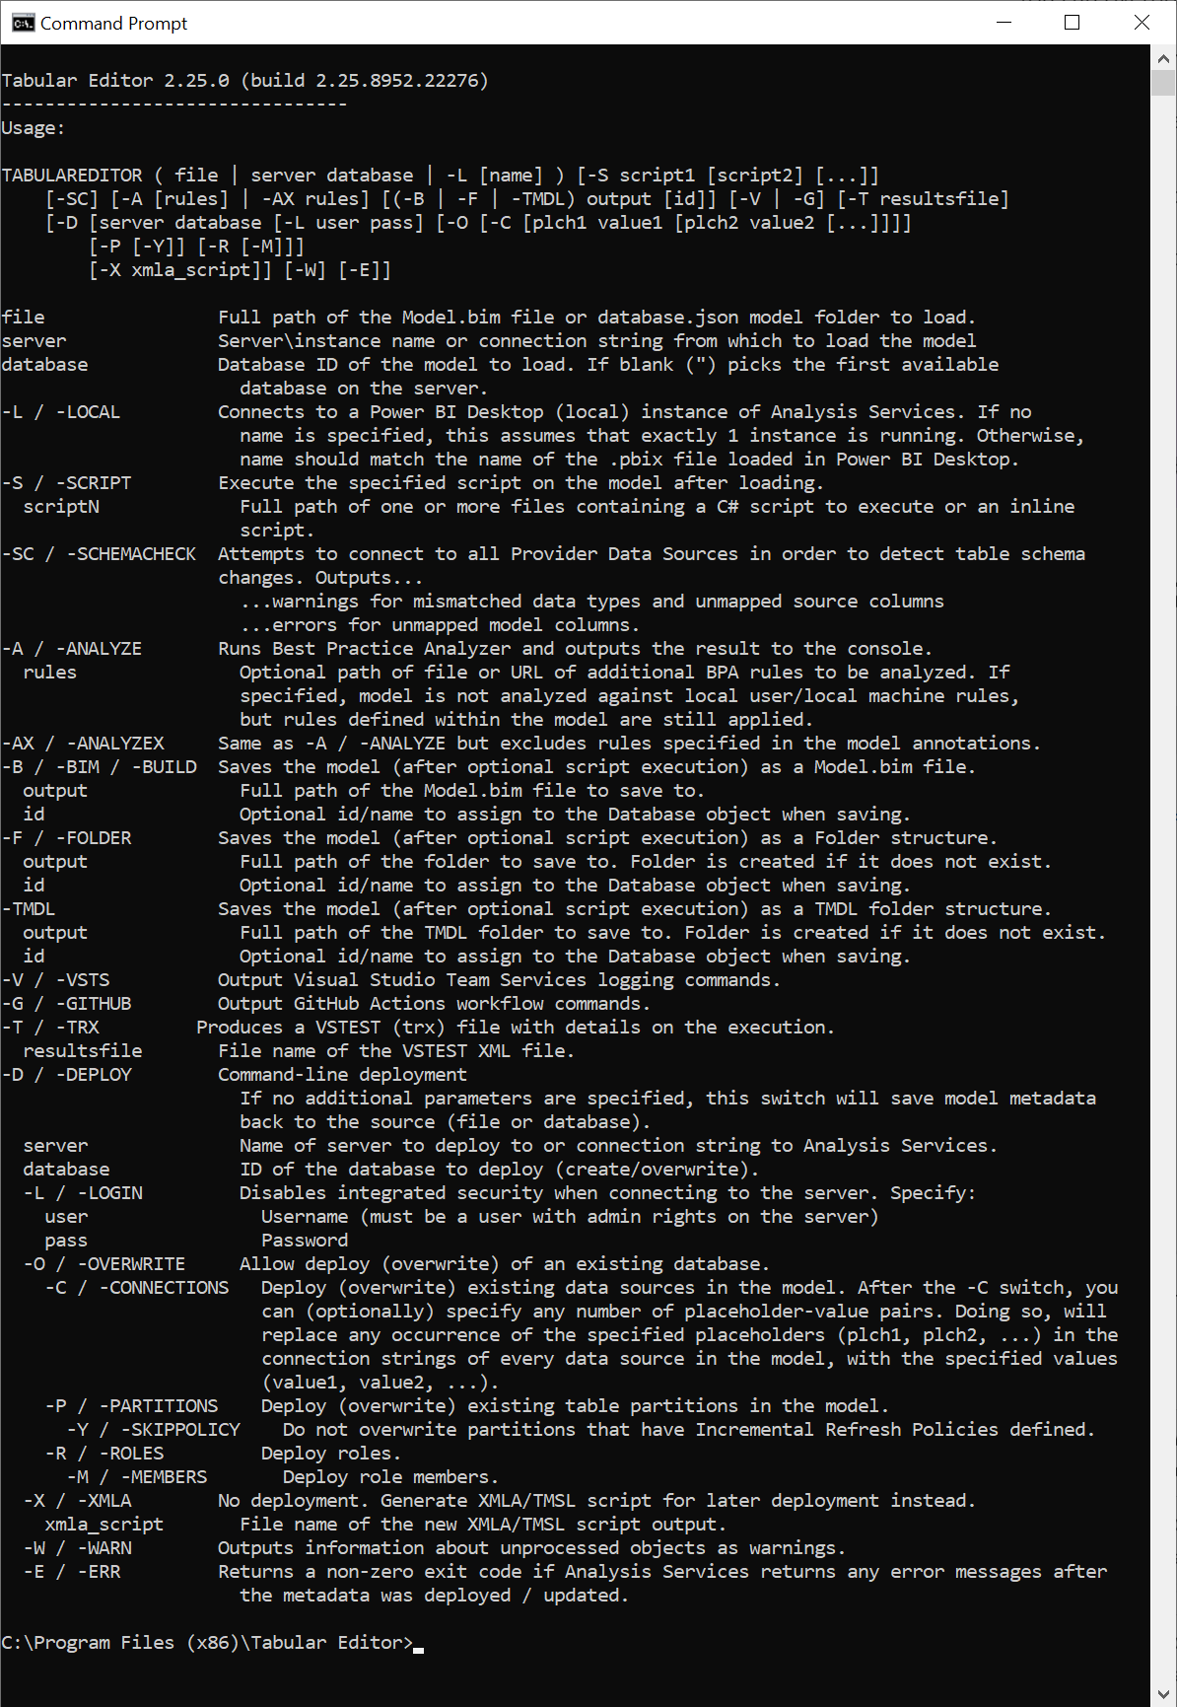
Automation with the Tabular Editor CLI

Slide 94
Why CLI?
Automate everything you can do through the TE UI
Useful for automated build / deployment pipelines
Execute C# scripts through CLI
Run Best Practice Analyzer
Load/save model metadata from/to various formats (.bim, “save-to-folder”, TMDL)
Deploy semantic model metadata

Slide 95
Passing data to C# scripts in CLI
Use environment variables to pass data to C# scripts, when executed through Tabular Editor CLI
In C# script, read environment variables as:
Environment.GetEnvironmentVariable("<variable-name");
Useful when C# script needs credentials, connection details, server names, or other pipeline-specific details
Bonus: In Azure DevOps and GitHub actions, pipeline variables are already mapped to environment variables when executing Windows CLI tasks

Slide 96
Demo
Tabular Editor CLI

Slide 97
Additional considerations
Semantic Modeling is so much more than what you see in Power BI Desktop
It pays off to have a solid understanding of TOM
Let’s you know what features are available in semantic models
Makes it easier for you to navigate the programmatic object model
Ultimately lets you write your own productivity-enhancing scripts
Rome wasn’t built in a day
There’s much to learn – we have only scratched the surface

Slide 98
Thank you!
All sample material and exercises available, if you want to spend more time working on it
https://github.com/otykier/training
If you want additional inspiration for C# scripts, check out my session tomorrow at 3:15 pm:
Tabular Editor Scripting Magic

